Slide 1
Biomarkers for Longevity
Alexander Lozano, MD, PhD

Slide 2
Disclosures
LiquidCell
Equity
September VC
General Partner

Slide 3
Age is perhaps the most important predictor of mortality
Our World in Data

Slide 4
As time marched forward, mortality at a given age has decreased

Slide 5
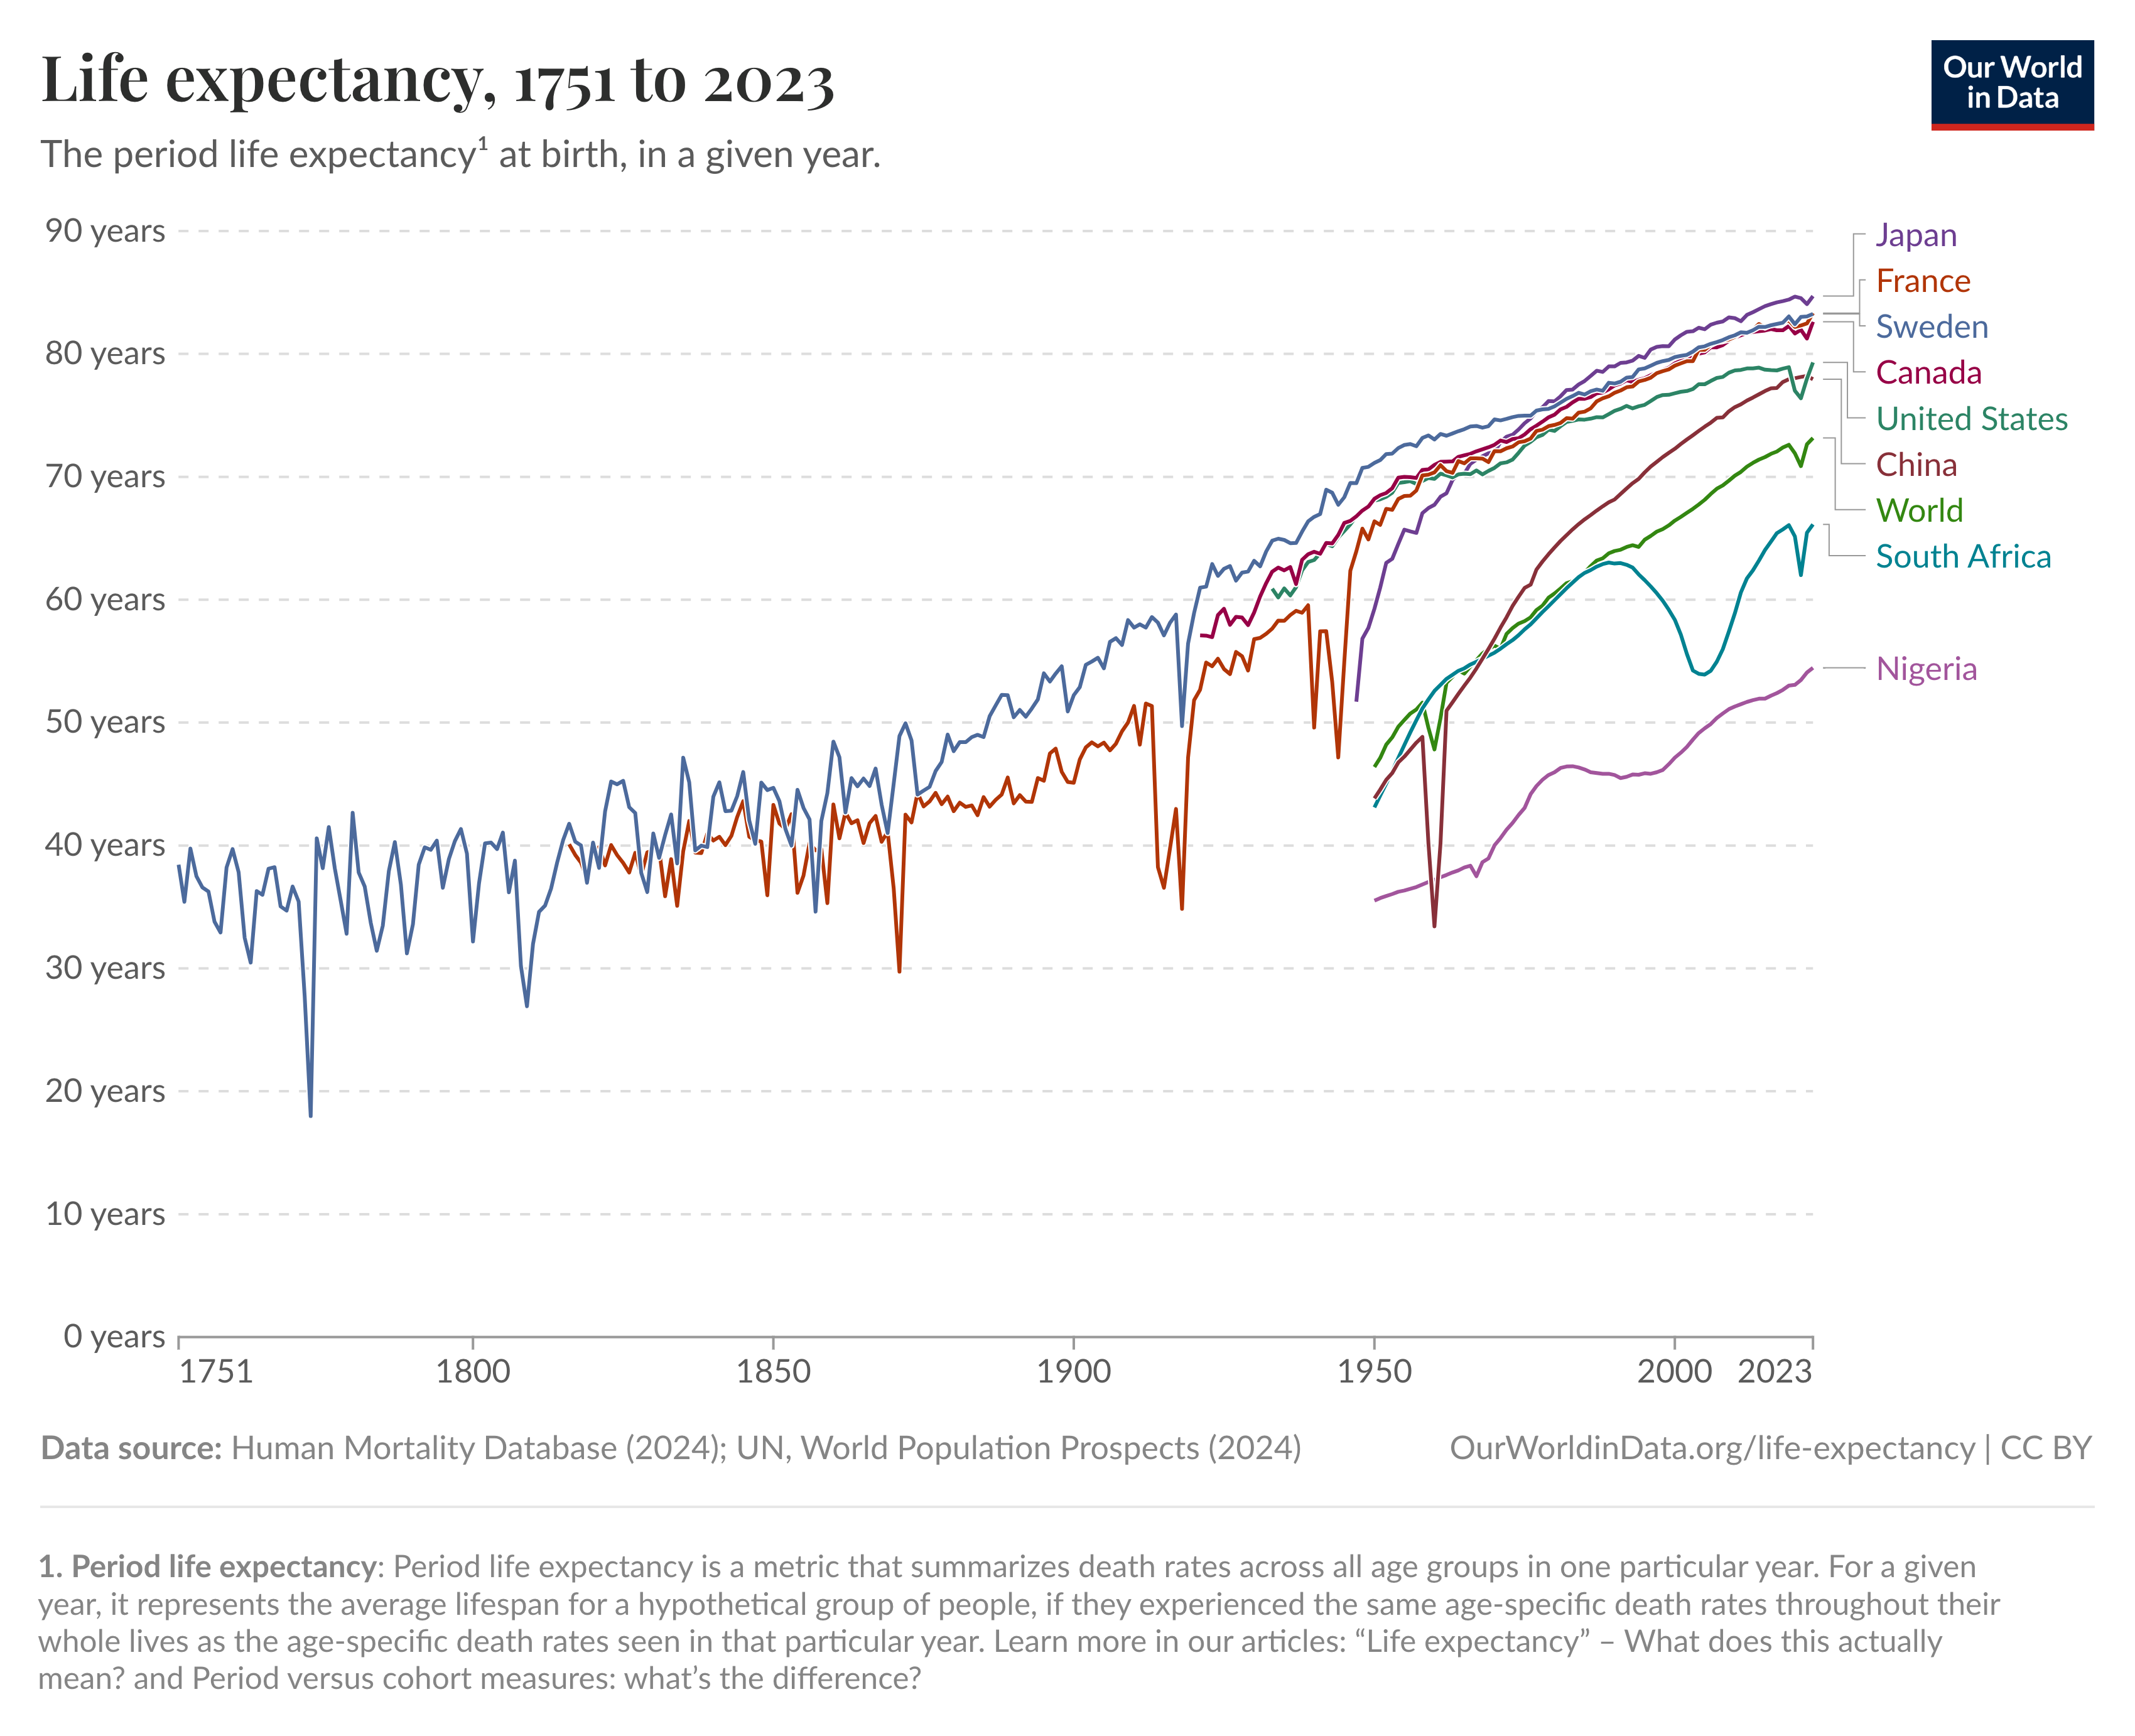
And life expectancy has increased

Slide 6
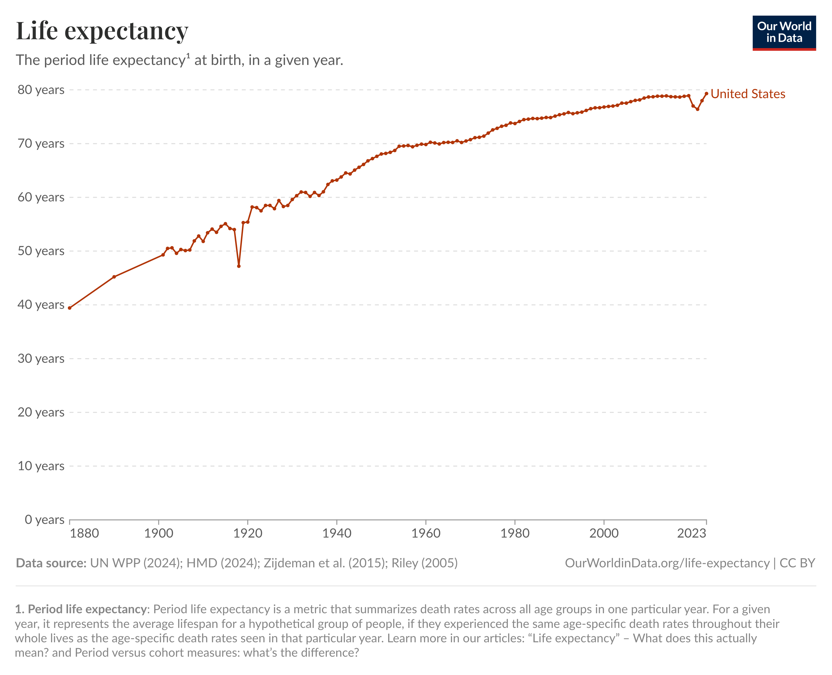
But recently American life expectancy has plateaued and even decreased

Slide 7
Healthspan is a measure that takes into account lifespan, and the years of life lived free from disease, disability, and suffering

Slide 8
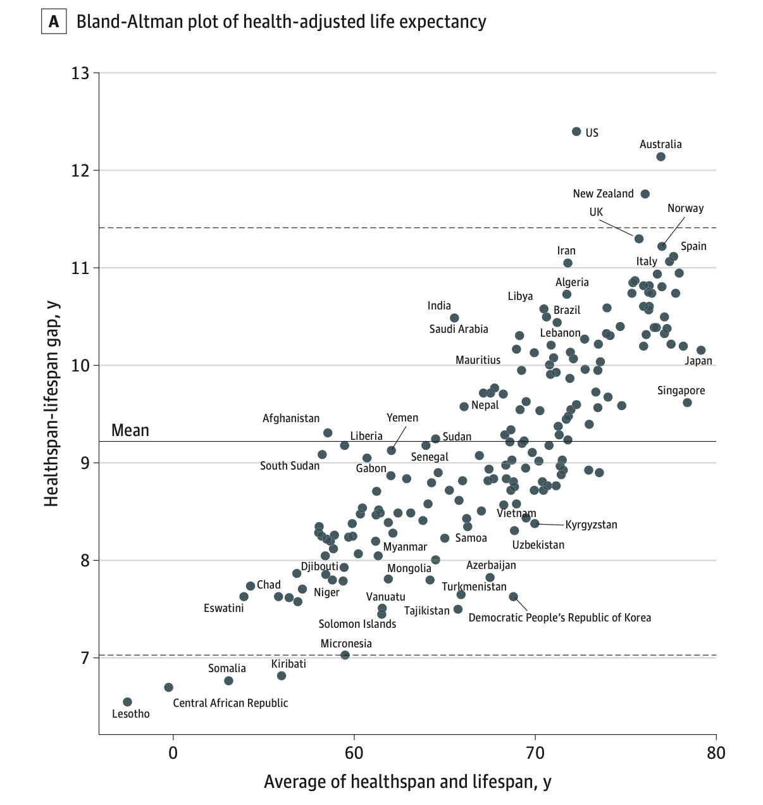
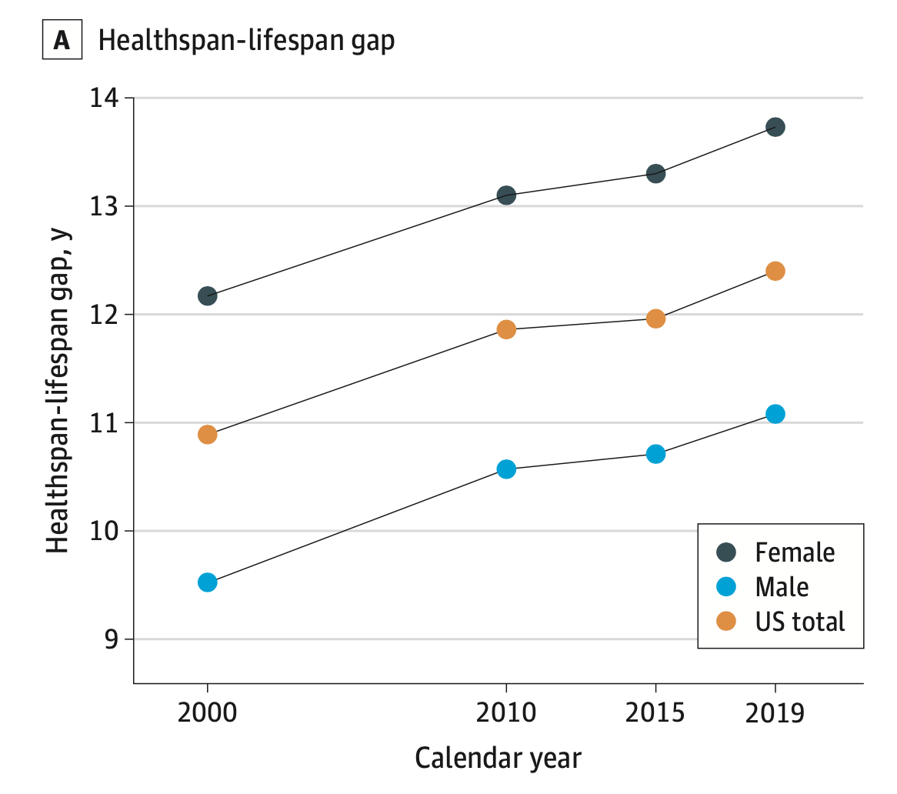
America leads the world in the gap between Health and Lifespan
Healthspan-adjusted Life Expectancy
US Healthspan-lifespan gap is increasing over time
Garmany, Armin, and Andre Terzic. "Global healthspan-lifespan gaps among 183 World Health Organization member states." JAMA Network Open 7.12 (2024): e2450241-e2450241.

Slide 9
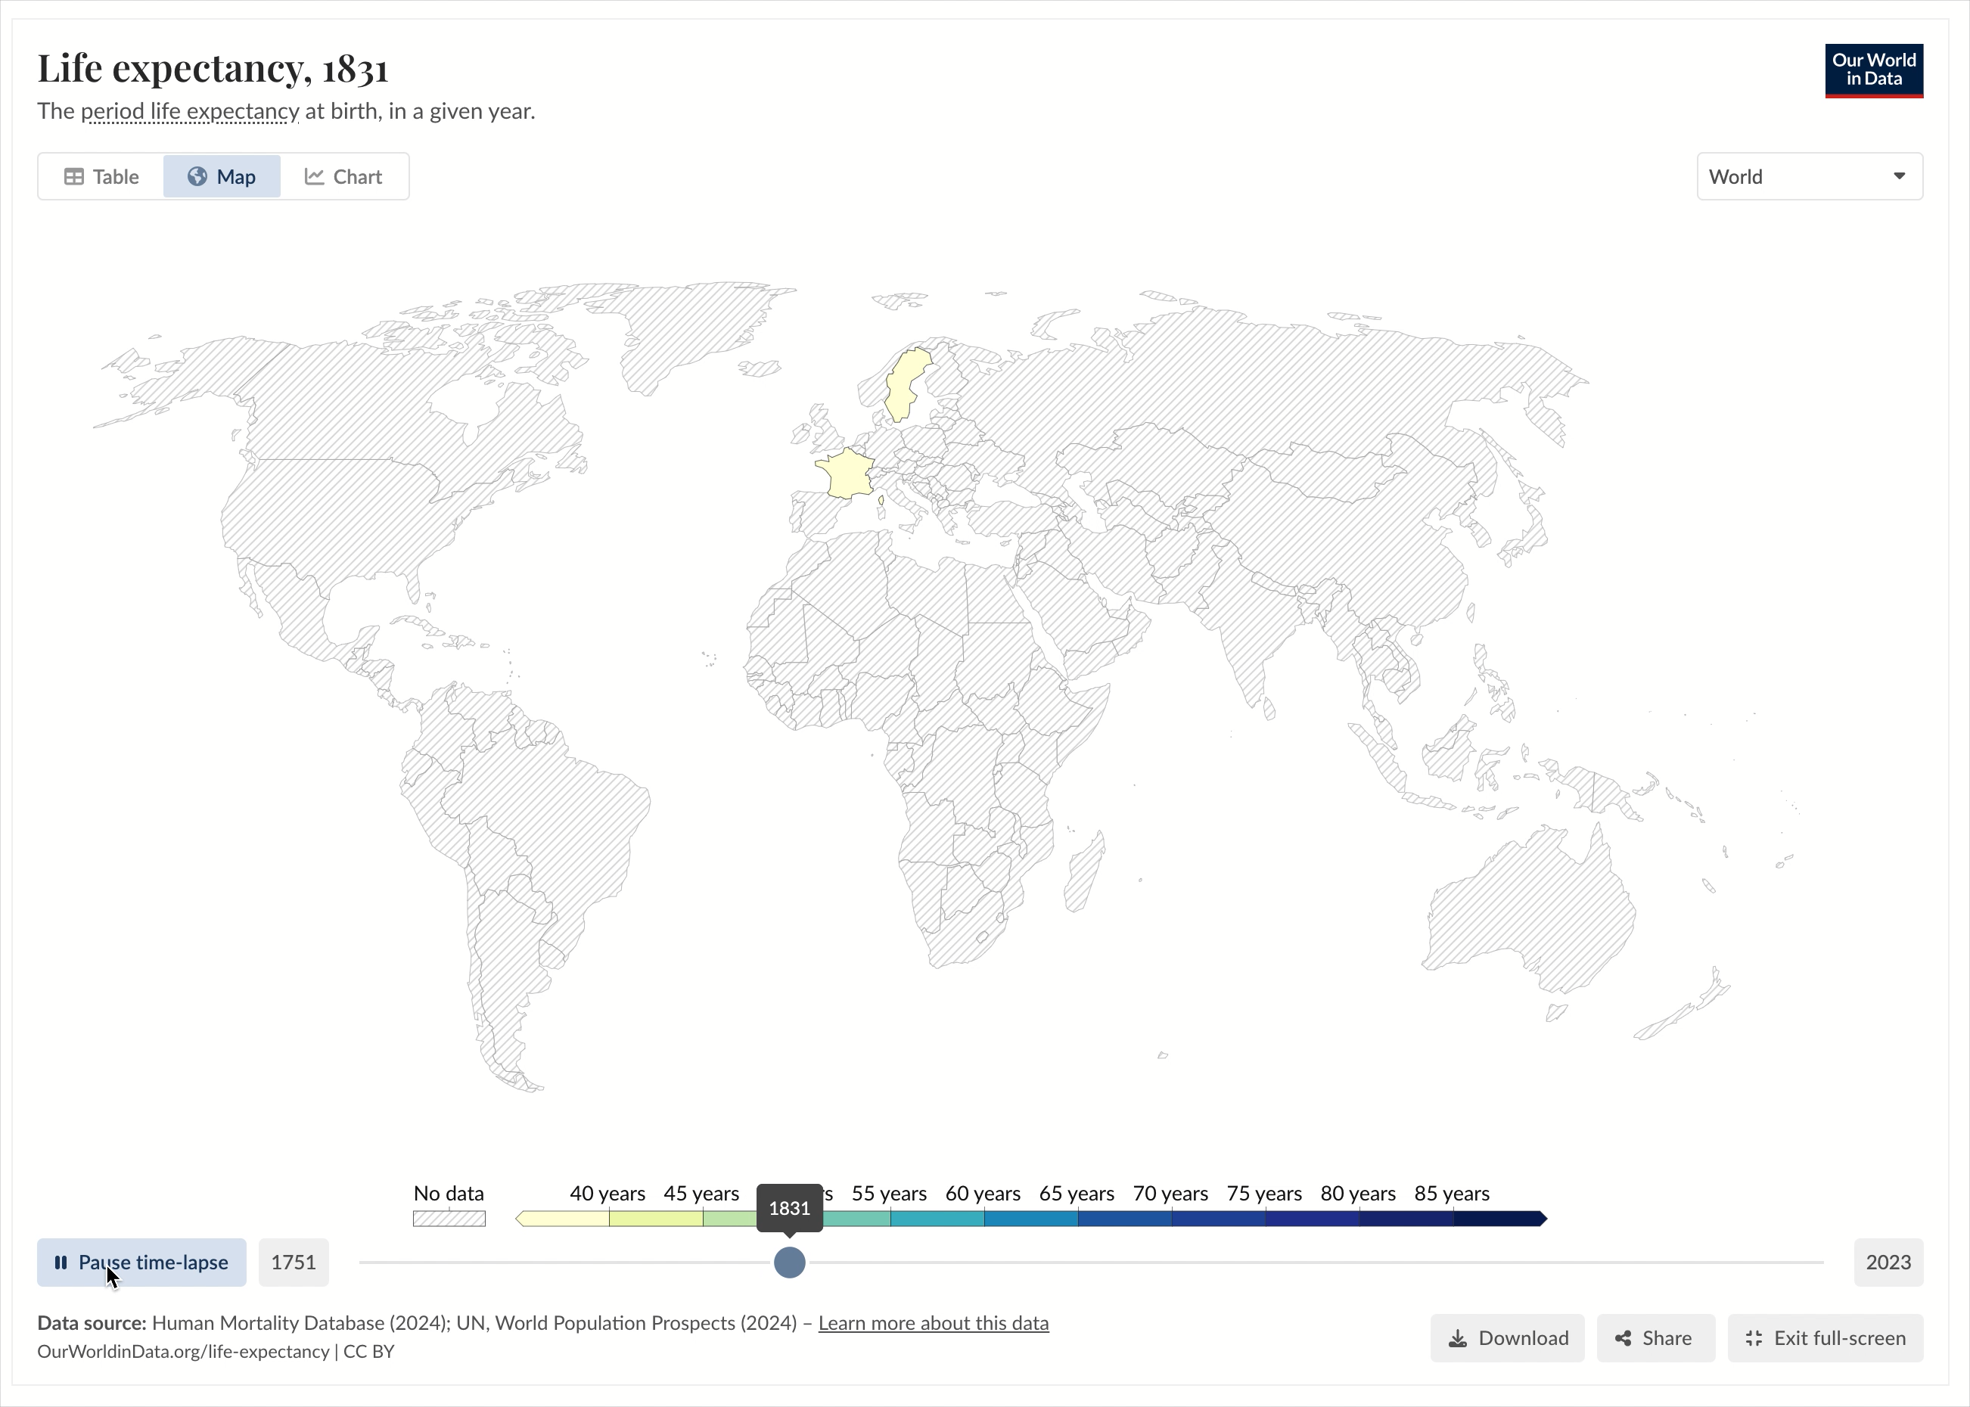

Slide 10
Scratching the surface of longevity, how can we figure out someone’s health?

Slide 11
Lets go back in time

Slide 12
Life expectancy in ancient times
1600,
~33 years
400 BC,
~25 years
400 BC
1600

Slide 13
400 BC
Life expectancy
~25 years
Aphorisms
Hippocrates
44. Persons who are naturally very fat are apt to die earlier than those who are slender.
Aphorisms, By Hippocrates, Written 400 B.C.E, Translated by Francis Adams
Life expectancy, Cambridge University press

Slide 14
You can tell a lot about health even before you do invasive tests

Slide 15
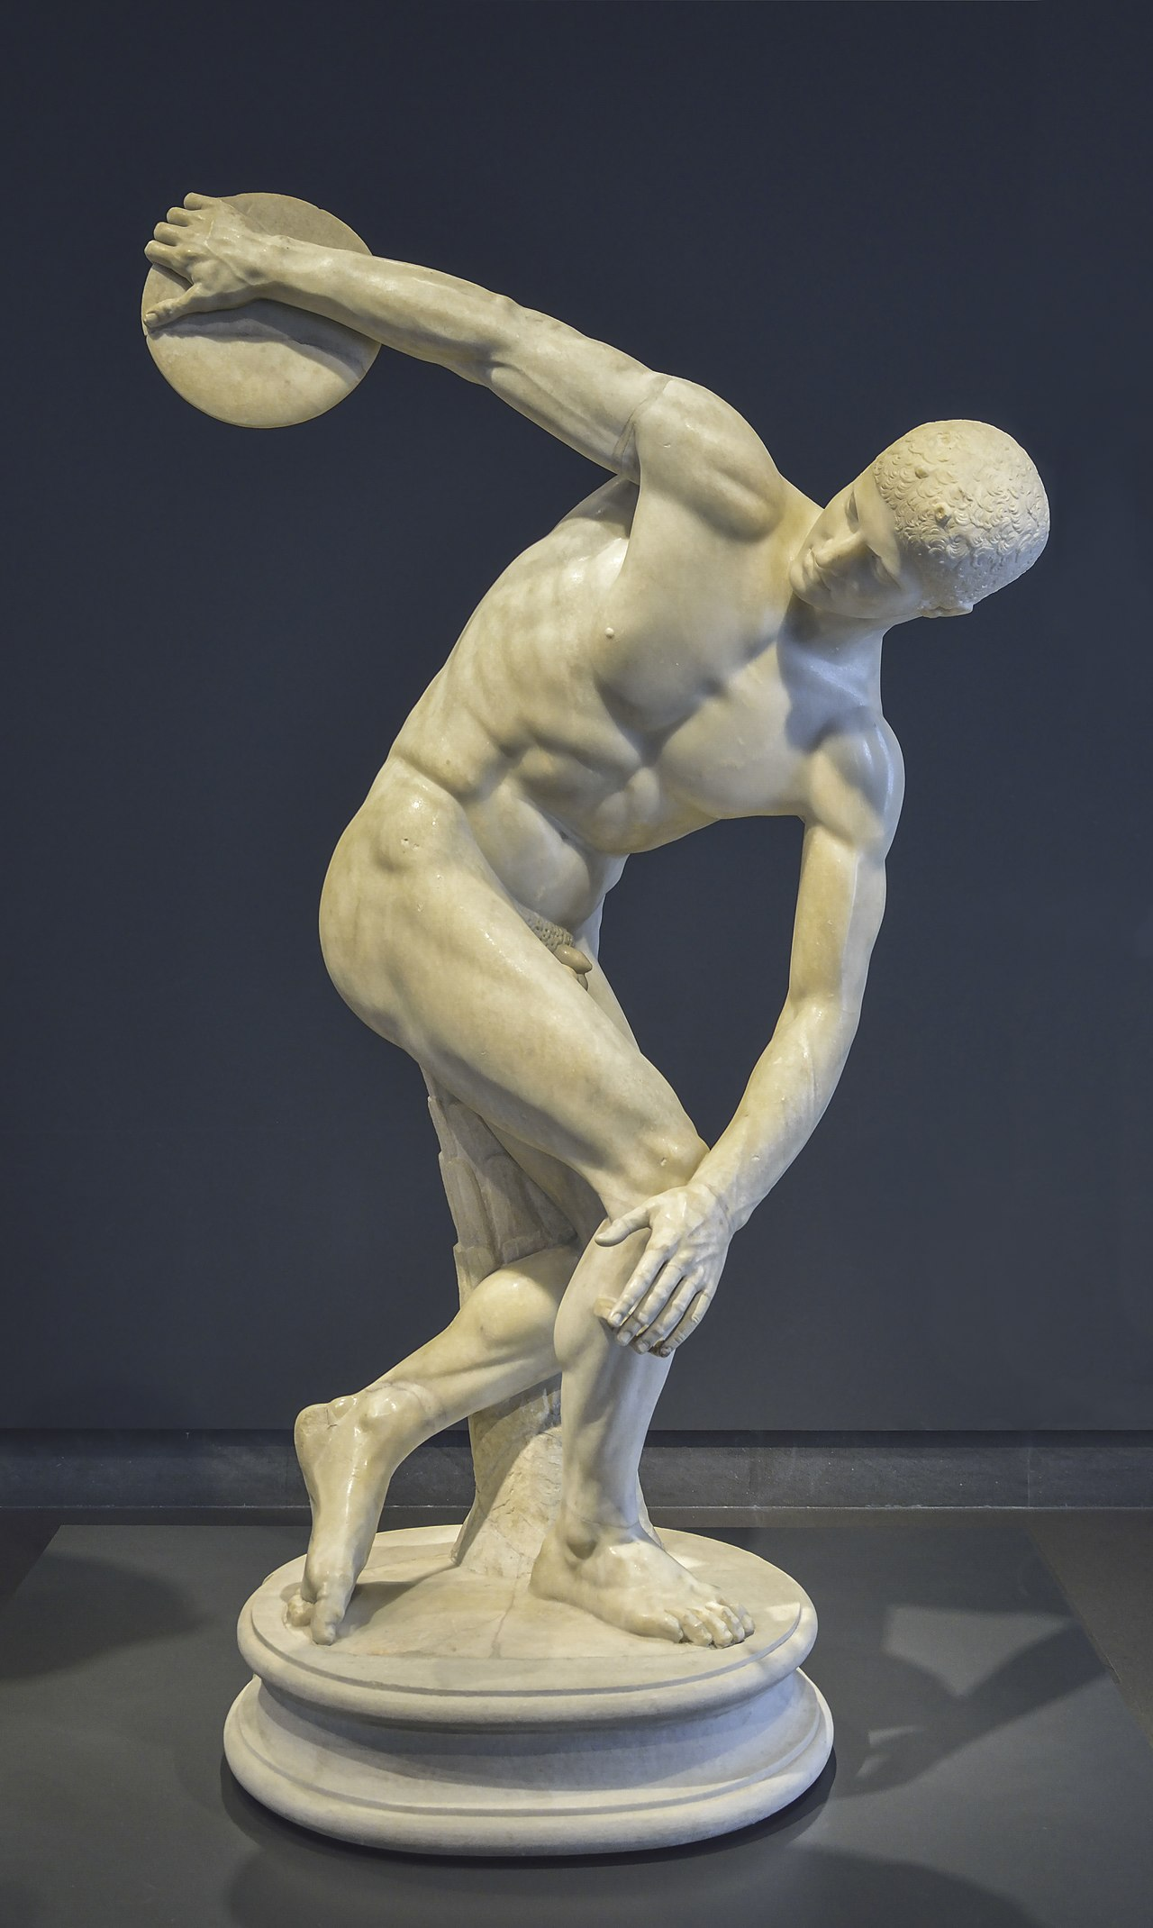
Discobolus by Myron, ~450 BC

Slide 16
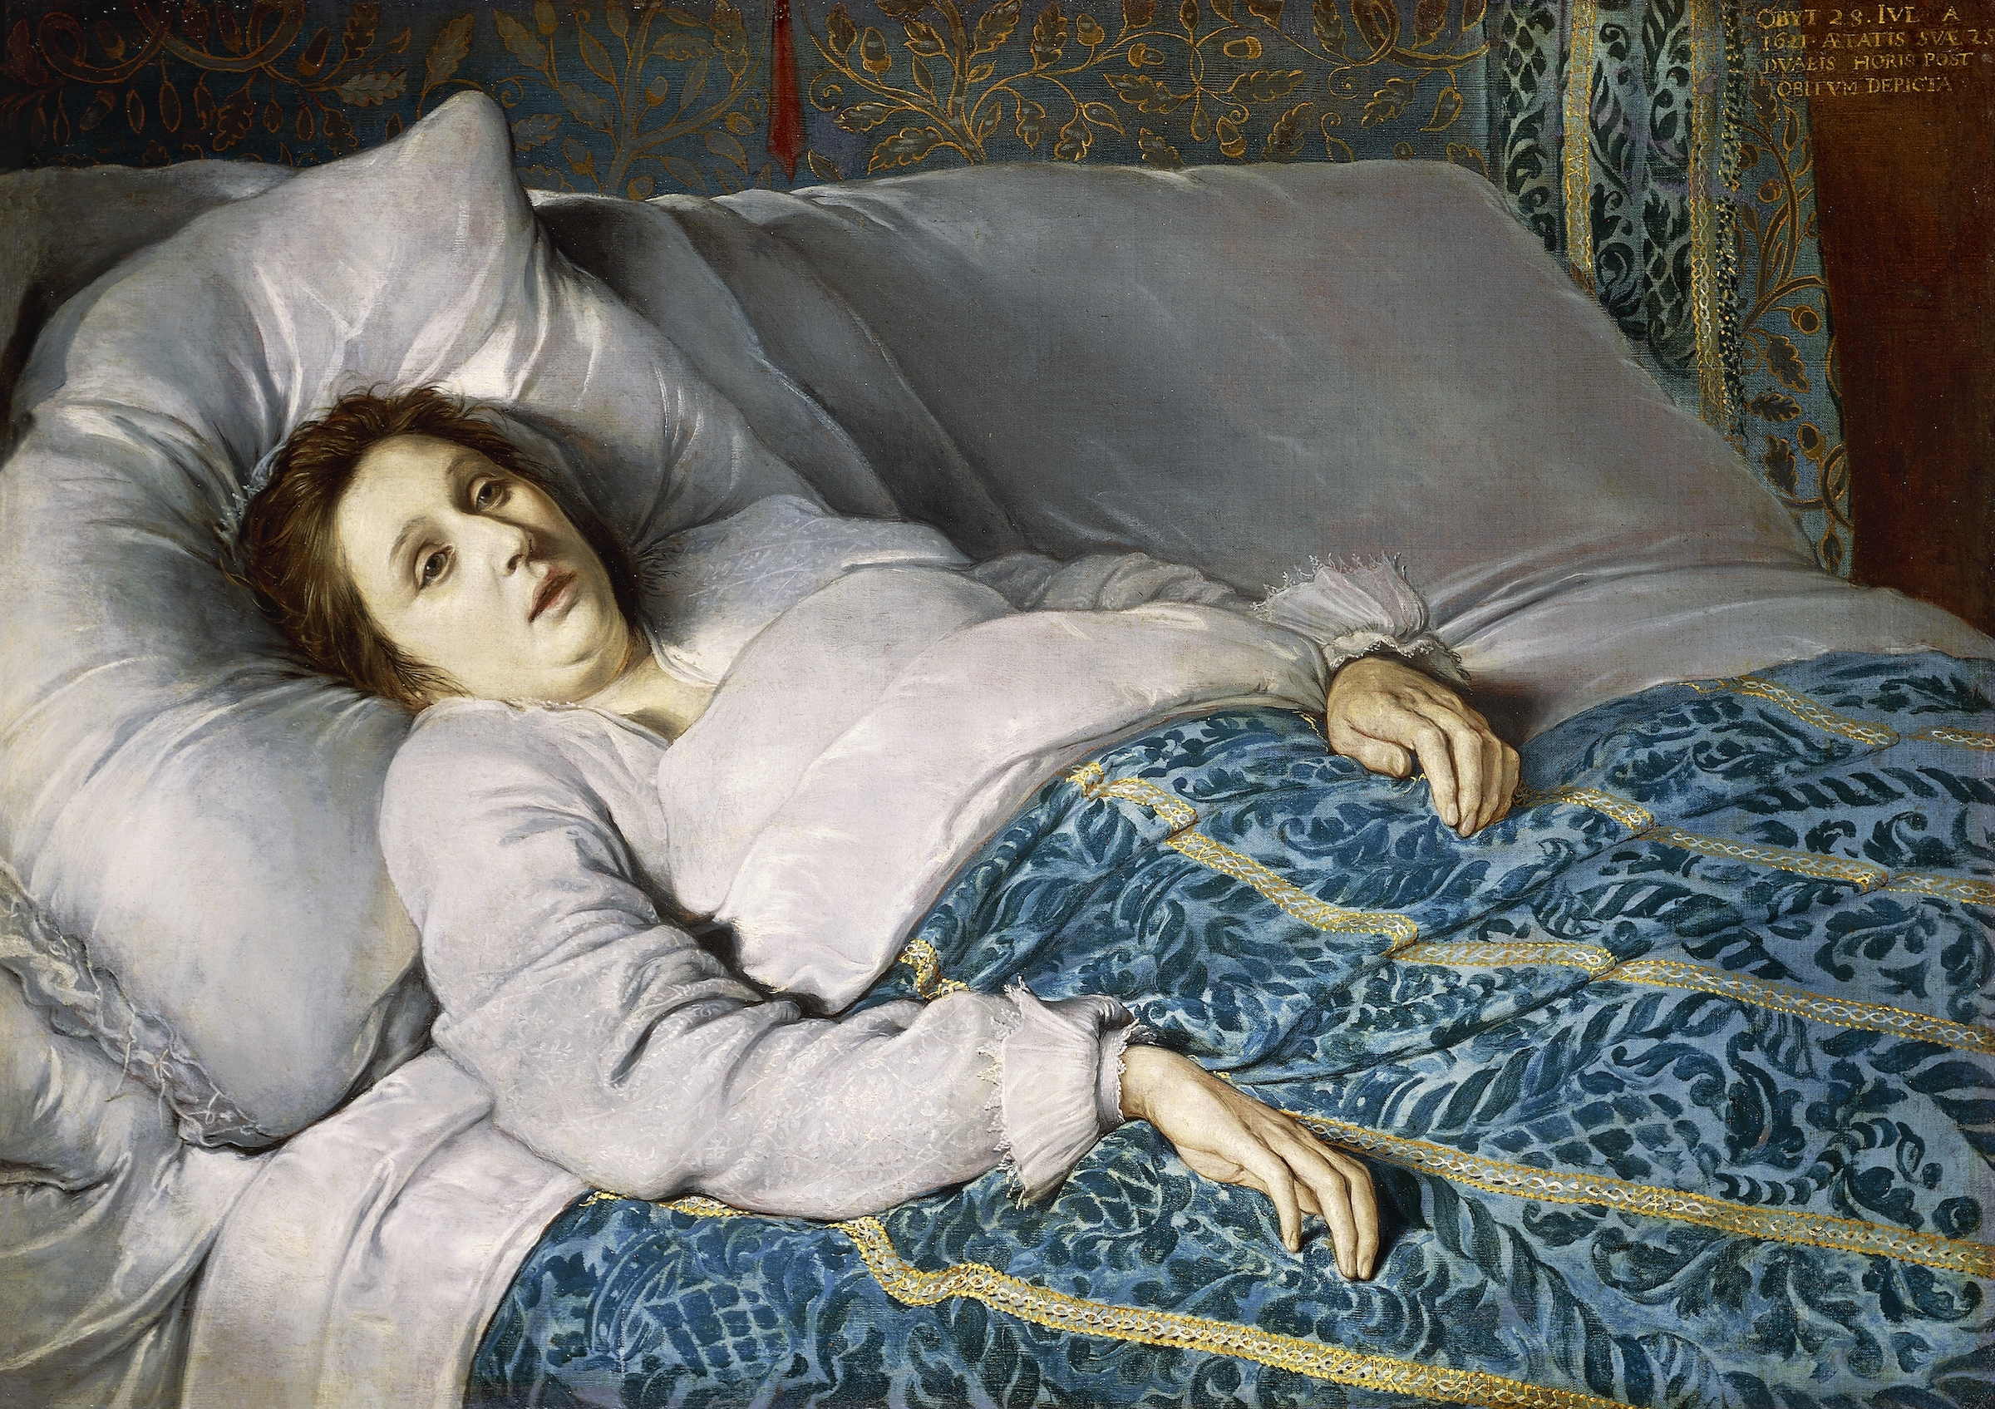
Discobolus by Myron, ~450 BC
Woman on Her Deathbed, anonyme, école flamande, 1621

Slide 17
Discobolus by Myron, ~450 BC
Woman on Her Deathbed, anonyme, école flamande, 1621
“LGFD”

Slide 18
In other words, it’s a vibe

Slide 19
But how can we quantify this ~vibe~

Slide 20
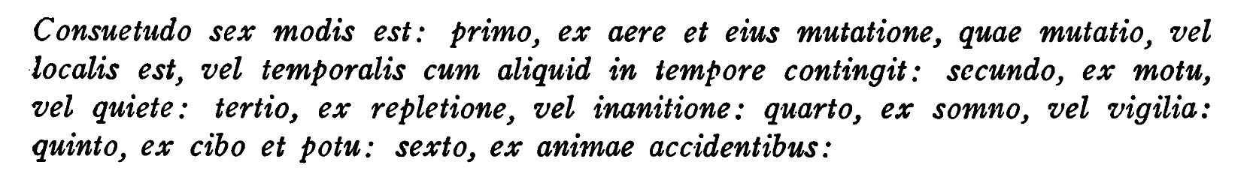
Galen’s 6 non naturals
~200 AD
Habit is in six ways: first, from the air and its change, which change is either local or temporal when something happens in time: second, from motion or rest: third, from repletion or starvation: fourth, from sleep or wakefulness: fifth, from food and drink: sixth, from accidents of the soul
Jarcho, Saul. "Galen's six non-naturals: a bibliographic note and translation." Bulletin of the History of Medicine 44.4 (1970): 372-377.

Slide 21
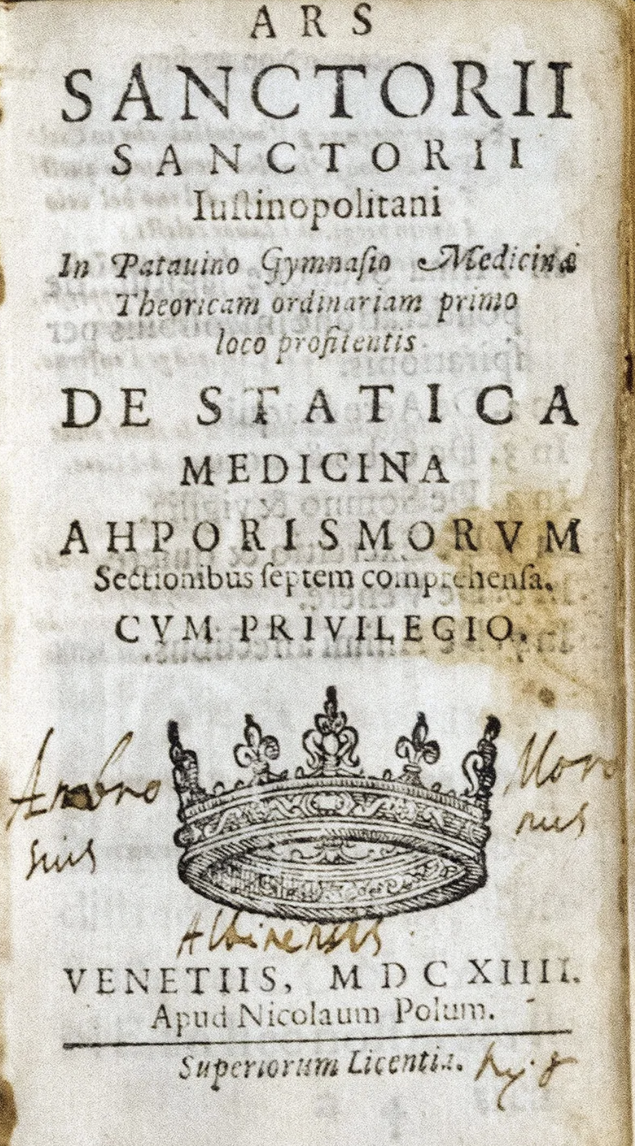
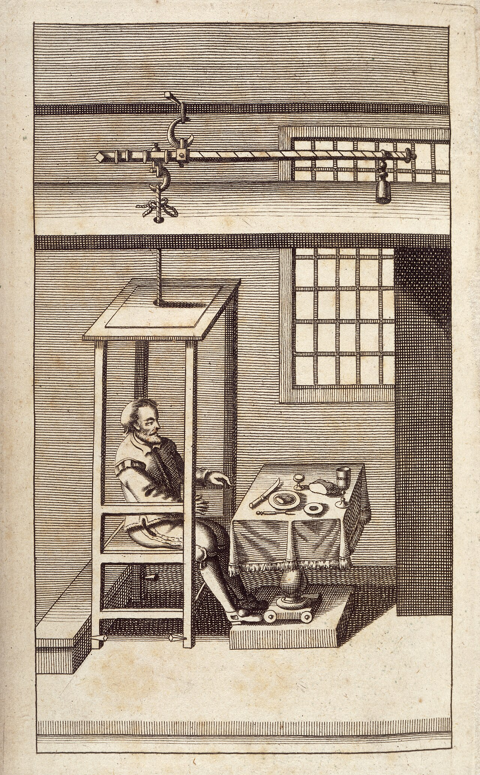
1614
Life expectancy: ~33
De Statica Medicina
Santorio Santorio
“He only who knows how much and when the body does more or less insensibly perspire, will be able to discern when and how much is to be added or taken away, either for the recovery or preservation of health”
Bigotti, Fabrizio. "Mathematica Medica. Santorio and the Quest for Certainty in Medicine." Journal of Healthcare Communications 1.4 (2016): 39-46.
https://www.verywellhealth.com/longevity-throughout-history-2224054

Slide 22
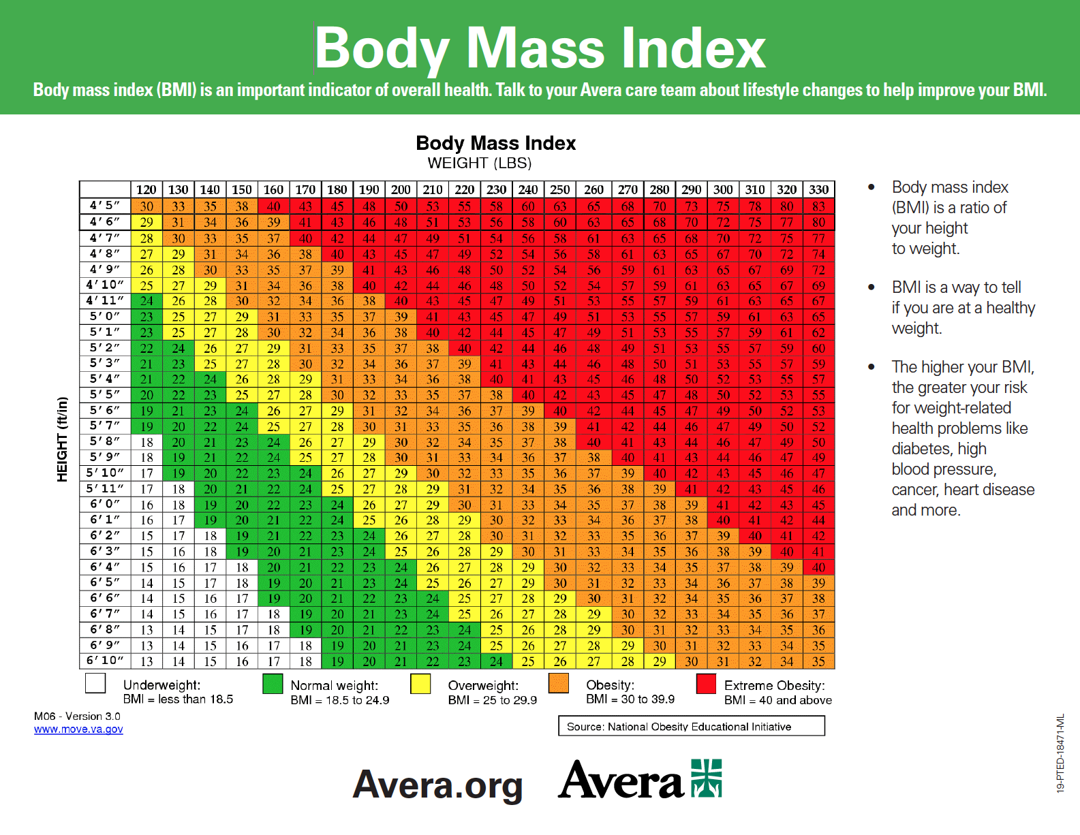
1832 The Quetlet Index
Life expectancy ~40
Renamed the Body Mass Index by Ancel Keys in 1972
Life expectancy 71.2
Image avera.org
Eknoyan, Garabed. "Adolphe Quetelet (1796–1874)—the average man and indices of obesity." Nephrology Dialysis Transplantation 23.1 (2008): 47-51.
https://www.verywellhealth.com/longevity-throughout-history-2224054

Slide 23
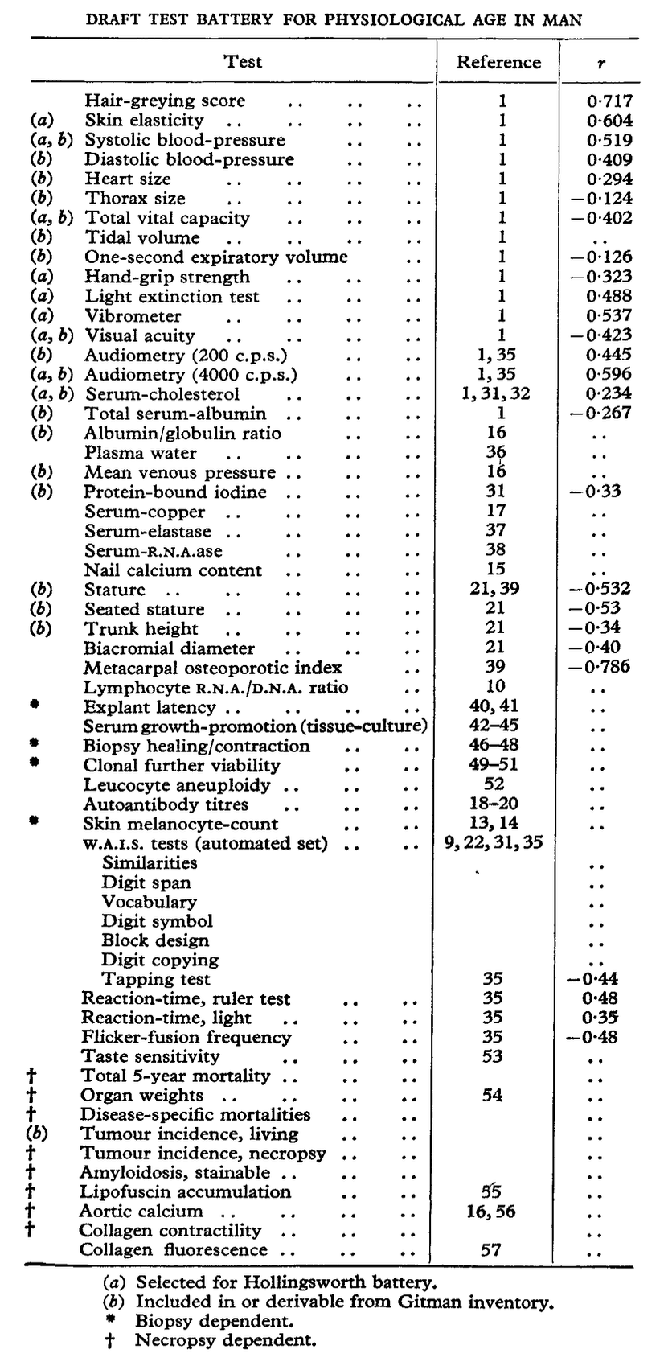
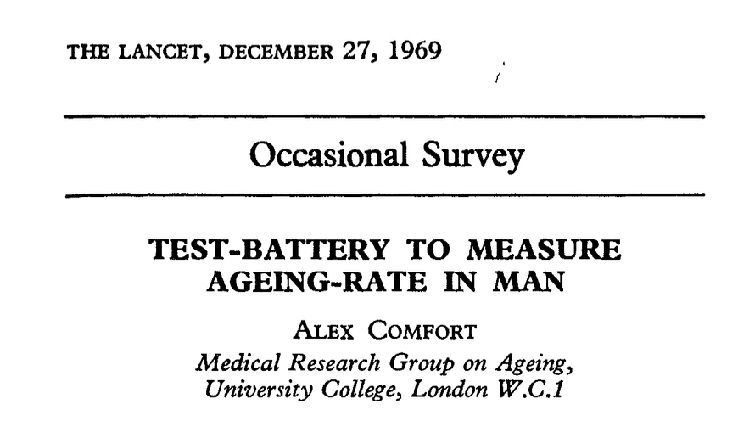
1969
Life expectancy 70.6

Slide 24
Vibes, visible and invisible are quantified by biomarkers

Slide 25
Biomarkers measurable indicators of a biological state.
They can help us to understand and measure
Age, health, and longevity

Slide 26
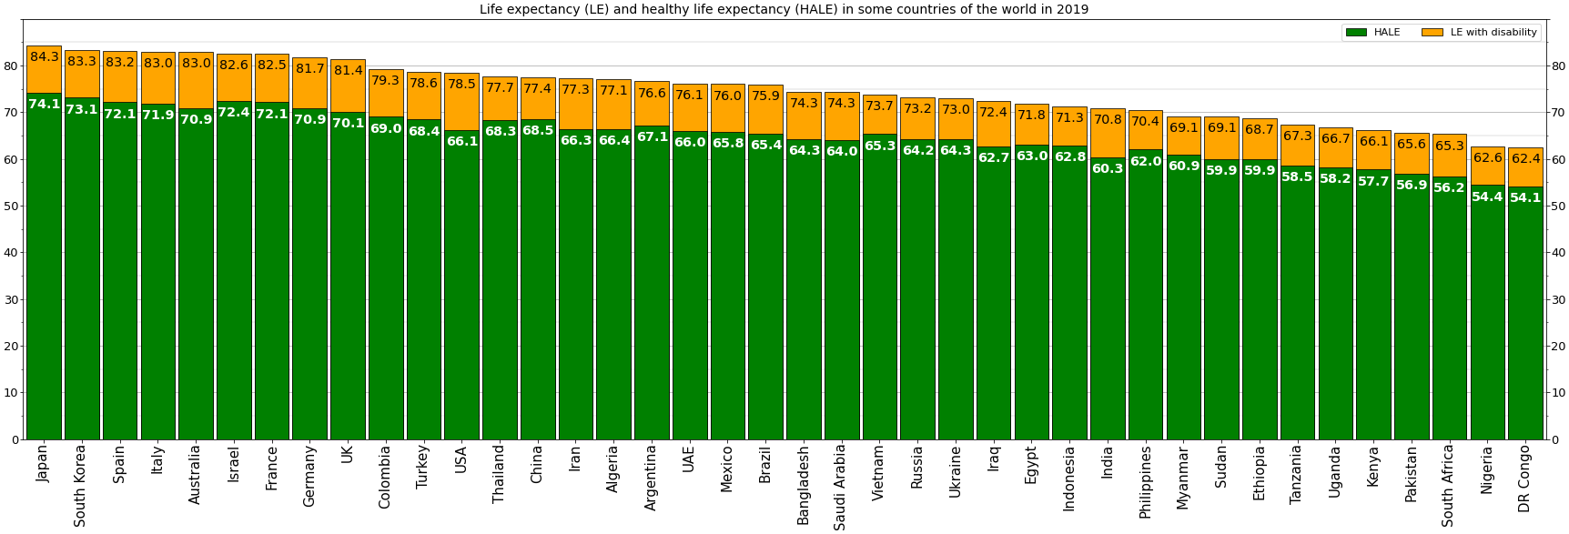
A good life is not only made up by additional age, but by age and health together
Wikipedia

Slide 27
You have years ahead of you, and I want those years to be filled with health and happiness

Slide 28
Age

Slide 29
Part of aging is executing a genetic program of development, another is the accumulation of the substances and experiences that we are exposed to in our lives
Moqri, Mahdi, et al. "Biomarkers of aging for the identification and evaluation of longevity interventions." Cell 186.18 (2023): 3758-3775.

Slide 30
Can you guess someone’s age by looking at them?

Slide 31
Can we fit to age using parameters in a blood test?

Slide 32
Can we fit to age using parameters in a blood test?
Patient chronological
ages
Chronological Age

Slide 33
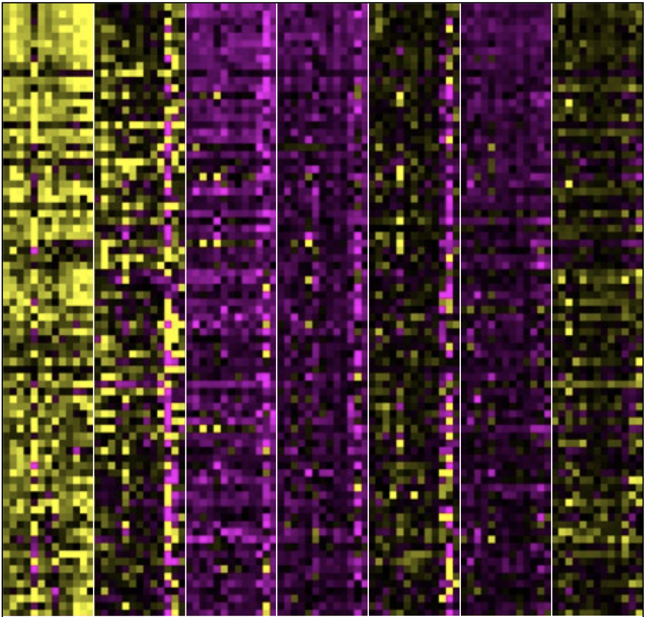
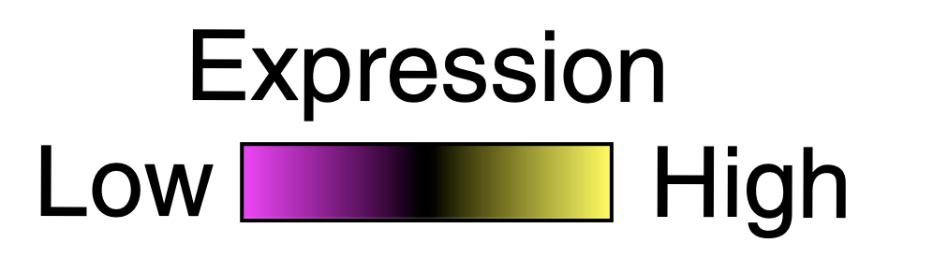
Can we fit to age using parameters in a blood test?
Patient chronological
ages
Expression of some
measurable quantities, per patient
Chronological Age

Slide 34
Can we fit to age using parameters in a blood test?
Patient chronological
ages
Expression of some
measurable quantities, per patient
Creating a biomarker by fitting a model to chronological age
Chronological Age

Slide 35
Plot chronological vs fitted biomarker age

Slide 36
In this way we create the biomarker age gap

Slide 37
Calculate the delta chronologic v. biomarker age
Positive Biomarker Age Gap
(predicted older than you are)
Chronological Age
Negative Biomarker Age Gap
(predicted younger than you are)
Biomarker Predicted Age

Slide 38
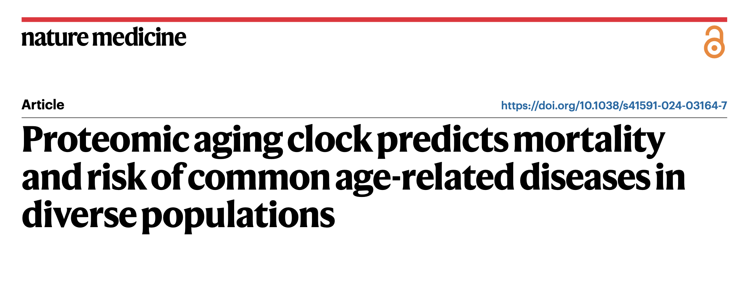
2023
Biomarker = an ensemble of proteins in the blood in a machine learning model
Biomarker Age = “ProtAge”
Biomarker Age Gap = “ProtAgeGap”

Slide 39
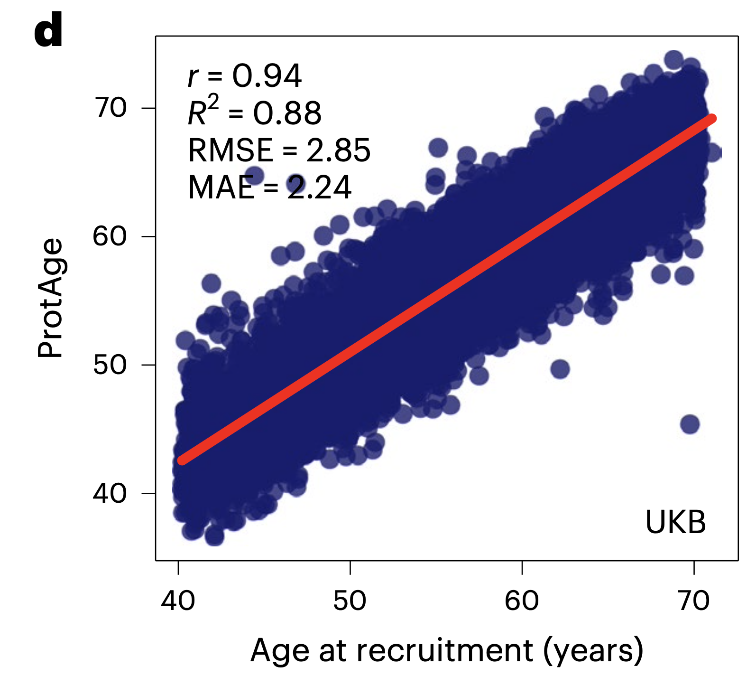
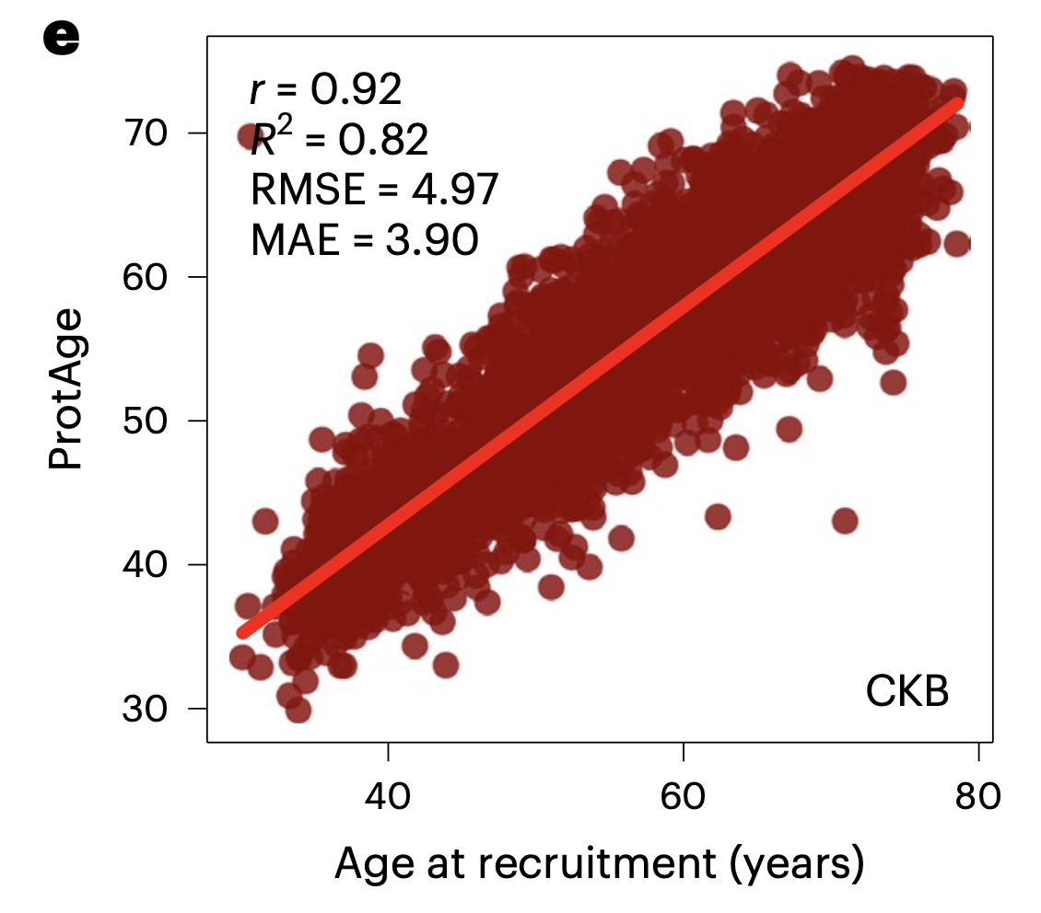
Evaluating the ProtAge Biomarker on the China Kadoorie Biobank
Biobank Database
Training the ProtAge Biomarker on the UK Biobank Database
Argentieri, M. Austin, et al. "Proteomic aging clock predicts mortality and risk of common age-related diseases in diverse populations." Nature medicine 30.9 (2024): 2450-2460.

Slide 40
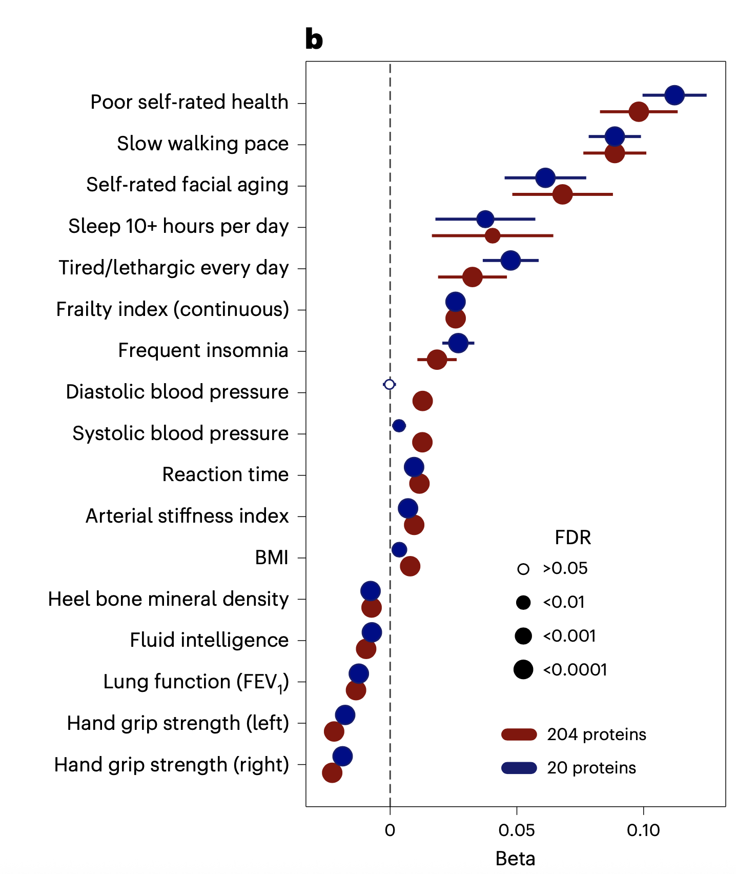
The ProtAge biomarker correlates with several other measurable biomarkers of health
Argentieri, M. Austin, et al. "Proteomic aging clock predicts mortality and risk of common age-related diseases in diverse populations." Nature medicine 30.9 (2024): 2450-2460.

Slide 41
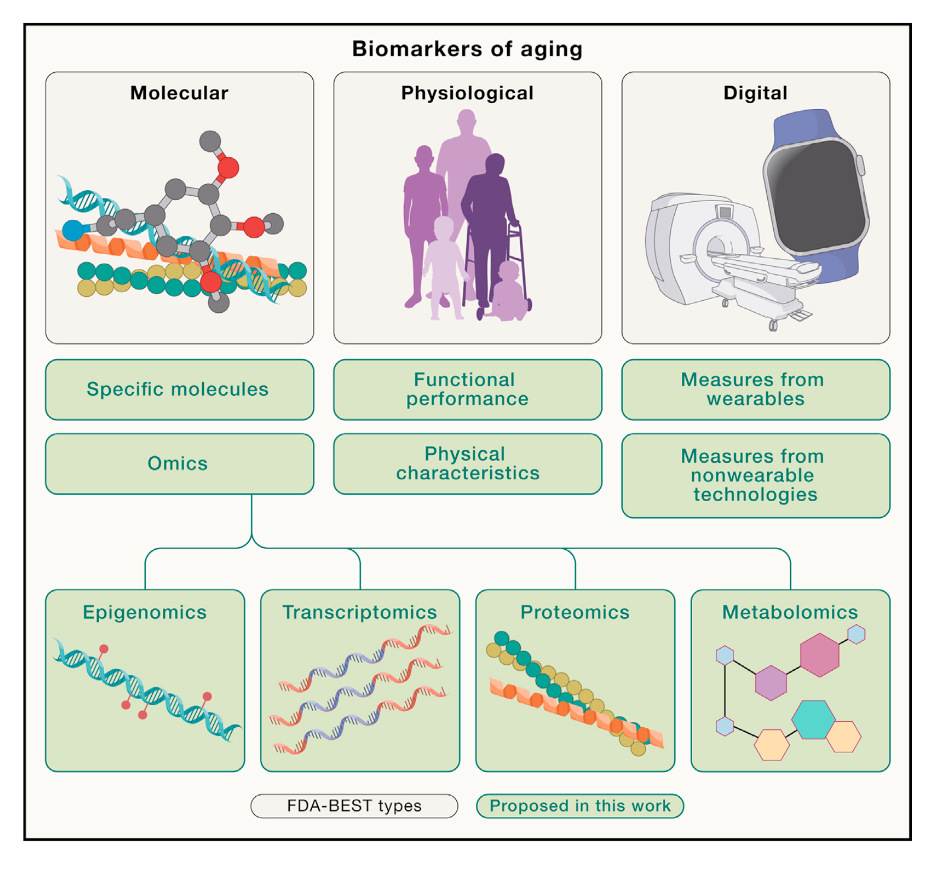
Some of the things we can measure: X-ome
Moqri, Mahdi, et al. "Biomarkers of aging for the identification and evaluation of longevity interventions." Cell 186.18 (2023): 3758-3775.

Slide 42
Some of the things we can measure: X-ome
Moqri, Mahdi, et al. "Biomarkers of aging for the identification and evaluation of longevity interventions." Cell 186.18 (2023): 3758-3775.

Slide 43
Some of the things we can measure: X-ome
Moqri, Mahdi, et al. "Biomarkers of aging for the identification and evaluation of longevity interventions." Cell 186.18 (2023): 3758-3775.

Slide 44
Some of the things we can measure: X-ome
Moqri, Mahdi, et al. "Biomarkers of aging for the identification and evaluation of longevity interventions." Cell 186.18 (2023): 3758-3775.

Slide 45
Some of the things we can measure: X-ome
Moqri, Mahdi, et al. "Biomarkers of aging for the identification and evaluation of longevity interventions." Cell 186.18 (2023): 3758-3775.

Slide 46
Some of the things we can measure: X-ome
Moqri, Mahdi, et al. "Biomarkers of aging for the identification and evaluation of longevity interventions." Cell 186.18 (2023): 3758-3775.

Slide 47
Some of the things we can measure: X-ome
Moqri, Mahdi, et al. "Biomarkers of aging for the identification and evaluation of longevity interventions." Cell 186.18 (2023): 3758-3775.

Slide 48
Some of the things we can measure: X-ome
Moqri, Mahdi, et al. "Biomarkers of aging for the identification and evaluation of longevity interventions." Cell 186.18 (2023): 3758-3775.

Slide 49
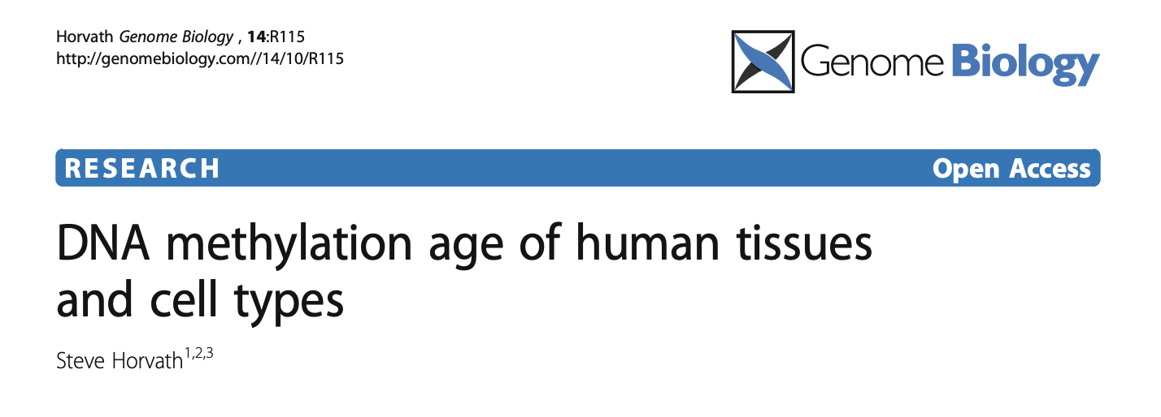
2013
Biomarker = methylation data
Biomarker Age = “Methylation Age”
This is commercially available (an open source avail)

Slide 50
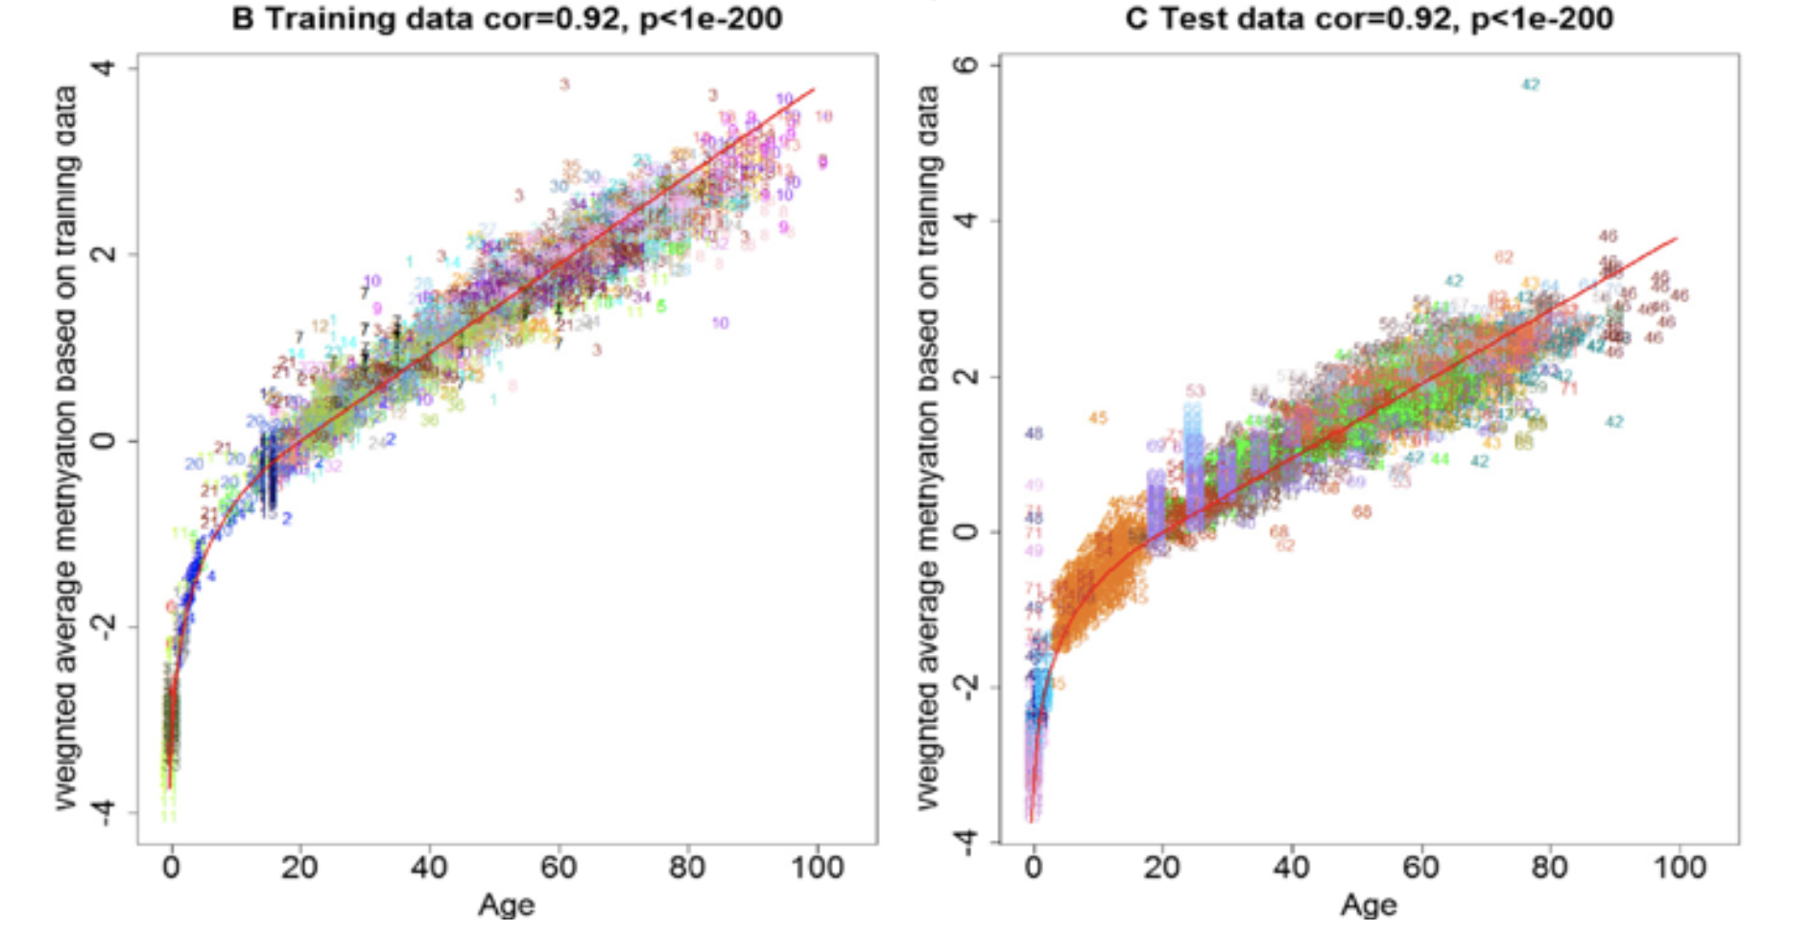
DNA methylation age of human tissues and cell types
The Horvath Clock
Horvath, Steve. "DNA methylation age of human tissues and cell types." Genome biology 14 (2013): 1-20.

Slide 51
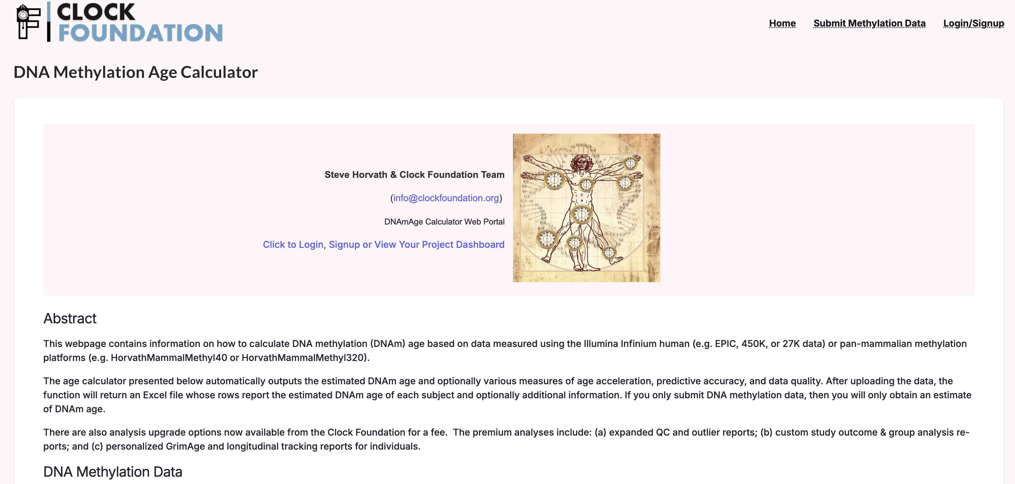
You can upload your or a patient’s methylome to obtain a methylation age

Slide 52
****DOES THIS CORRELATE WITH ORGAN SPECIFIC HEALTH OUTCOMES
*** CONSEQUENCES OF METHYLATION DATA

Slide 53
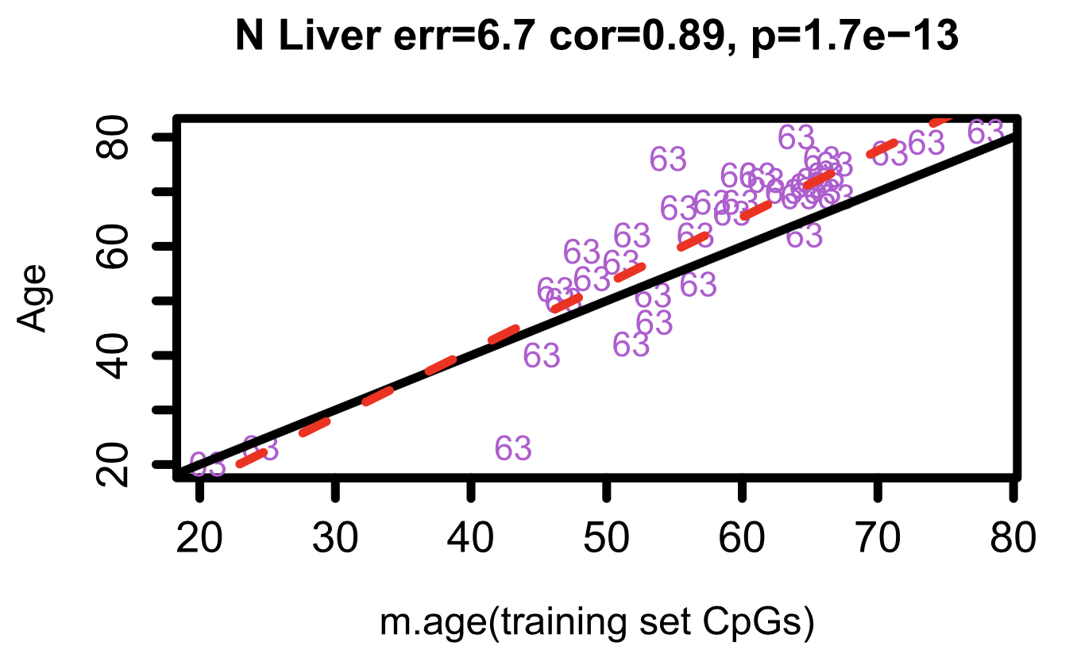
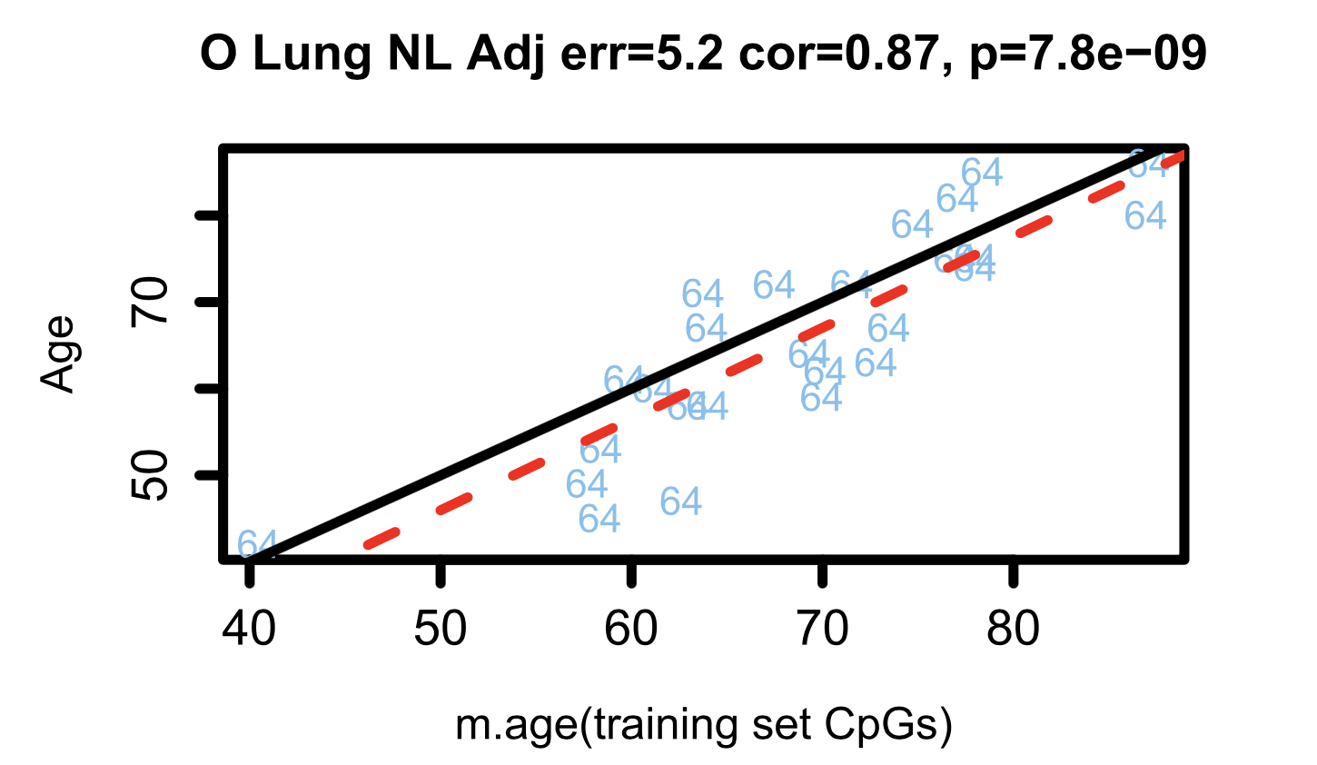
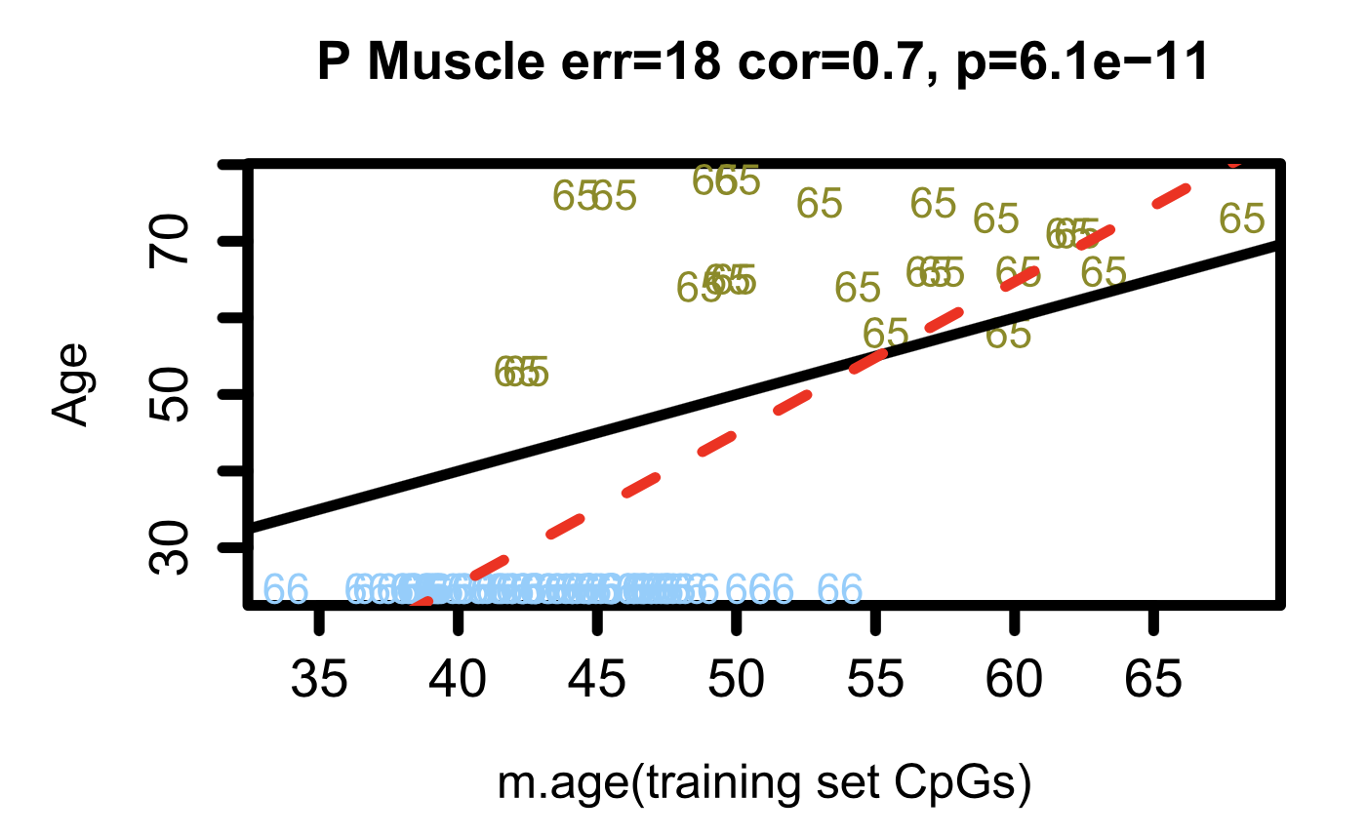
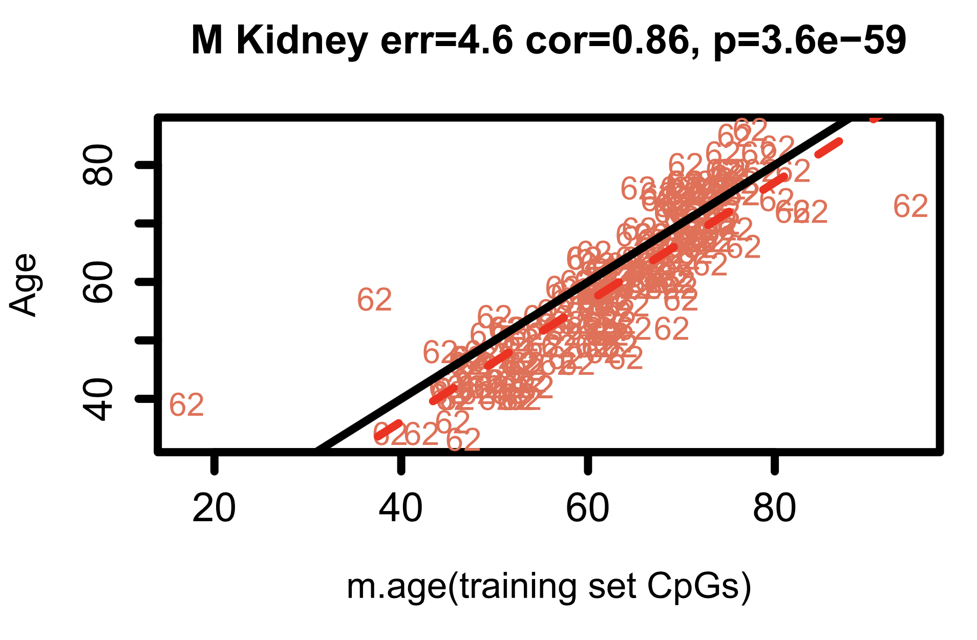
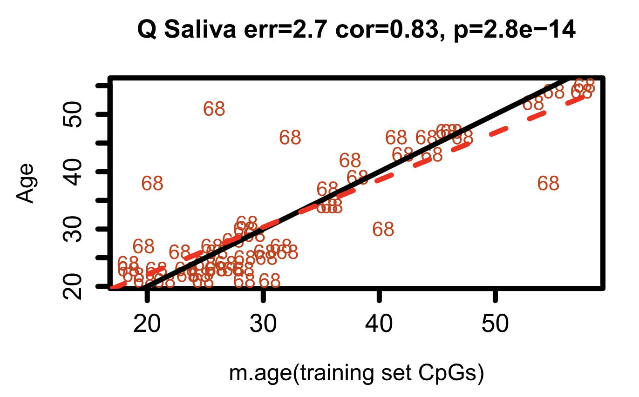
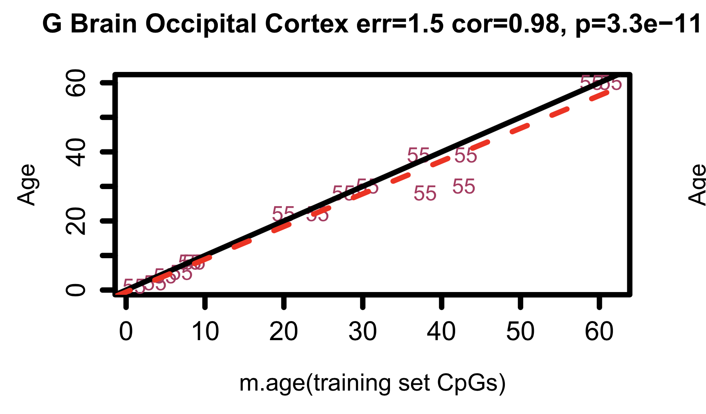
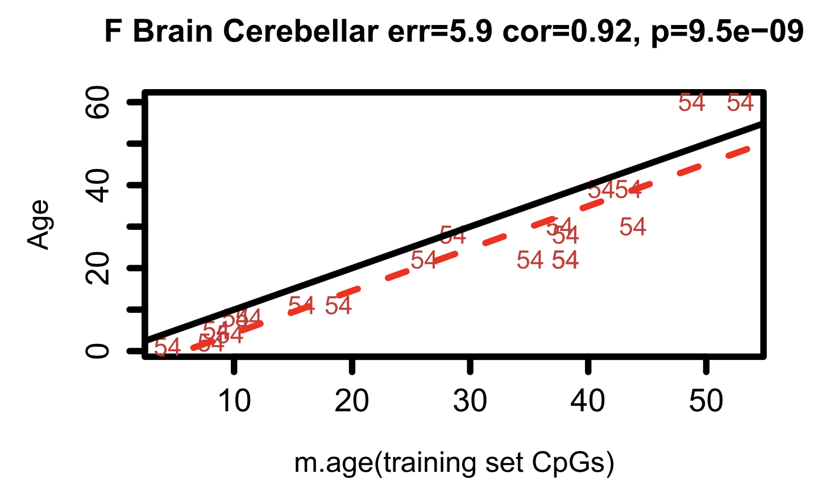
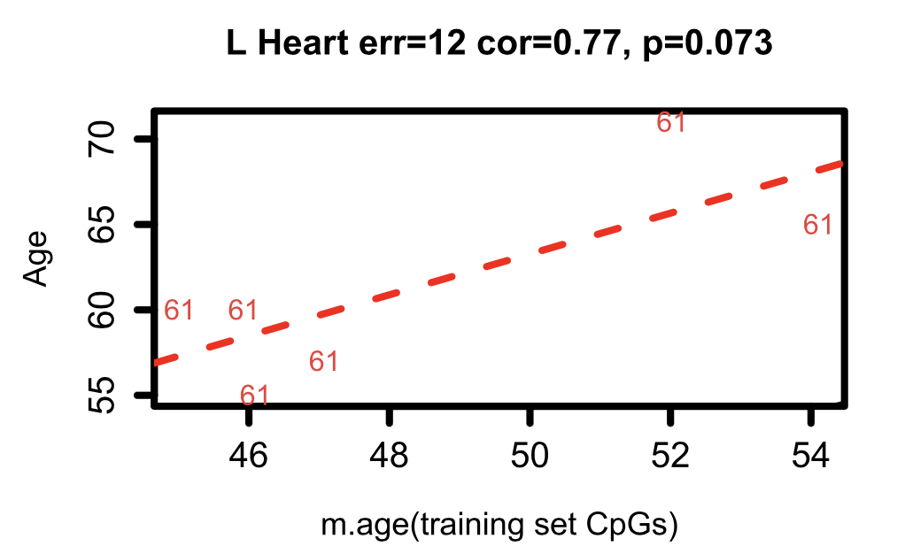
We can probe methylation age from tissue in each specific organ
Liver
Lung
Muscle
Kidney
True Human Age
Saliva
Brain (Occipital Cortex)
Brain (Cerrebelum)
Heart
Horvath, Steve. "DNA methylation age of human tissues and cell types." Genome biology 14 (2013): 1-20.
Methylation Age (Trained on CpG sites in the paper’s training set)

Slide 54
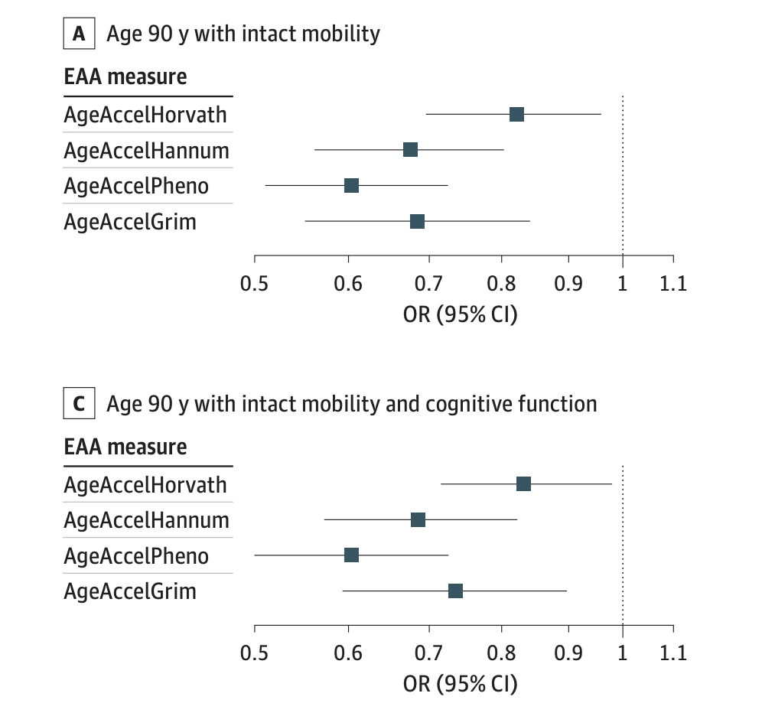
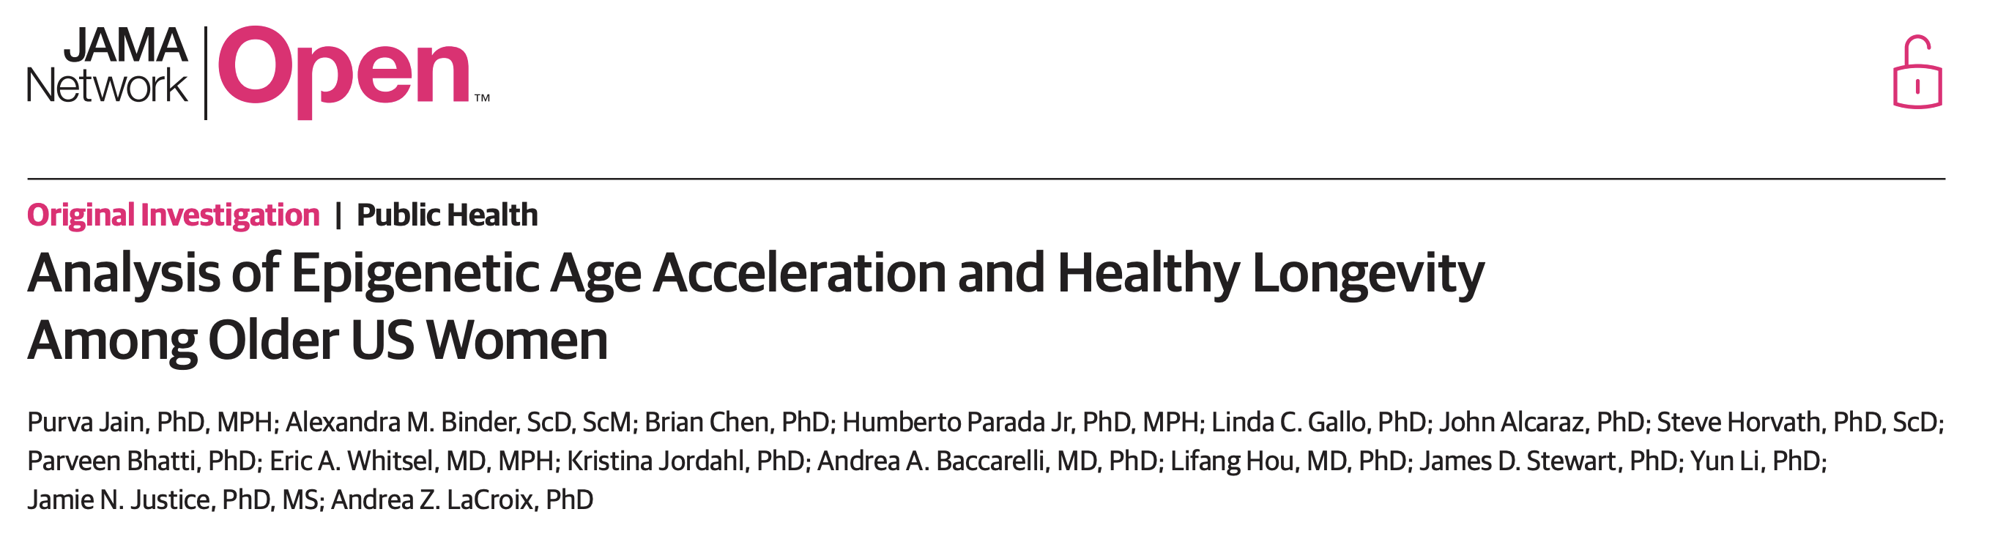
Epigenetic age correlates with longevity, intact mobility, and cognitive function
Does Jain, Purva, et al. "Analysis of epigenetic age acceleration and healthy longevity among older US women." JAMA network open 5.7 (2022): e2223285-e2223285.

Slide 55
Can we measure multidimensional age, and in so doing obtain insights that will allow us to slow the march of time

Slide 56
Are there multiple dimensions to Age?

Slide 57
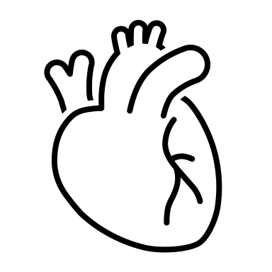
Lung
Liver
Kidneys
Cardiovascular
(Tissues of the blood vessels, and heart)
Cancer
Frailty

Slide 58

Lung
Liver
Kidneys
Cardiovascular
(Tissues of the blood vessels, and heart)
Cancer
Frailty
Metabolic
(The ensemble of metabolic interactions in our body)

Slide 59
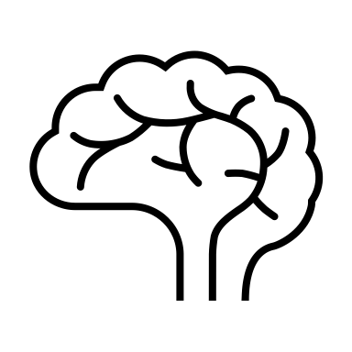
Lung
Liver
Kidneys
Cardiovascular
(Tissues of the blood vessels, and heart)
Cancer
Frailty
Neurological
(Tissues of the nervous system)
Metabolic
(The ensemble of metabolic interactions in our body)

Slide 60
Lung
Liver
Kidneys
Cardiovascular
(Tissues of the blood vessels, and heart)
Genetics
Cancer
Frailty
Neurological
(Tissues of the nervous system)
Metabolic
(The ensemble of metabolic interactions in our body)

Slide 61
Lung
Liver
Kidneys
Cardiovascular
(Tissues of the blood vessels, and heart)
Genetics
Cancer
Frailty
Environment
Neurological
(Tissues of the nervous system)
Metabolic
(The ensemble of metabolic interactions in our body)

Slide 62
Lung
Liver
Kidneys
Cardiovascular
(Tissues of the blood vessels, and heart)
Genetics
Cancer
Heart Attack
Frailty
Environment
Neurological
(Tissues of the nervous system)
Metabolic
(The ensemble of metabolic interactions in our body)

Slide 63
Lung
Liver
Kidneys
Cardiovascular
(Tissues of the blood vessels, and heart)
Genetics
Cancer
Heart Attack
Frailty
COPD
Environment
Neurological
(Tissues of the nervous system)
Metabolic
(The ensemble of metabolic interactions in our body)

Slide 64
Lung
Liver
Kidneys
Cardiovascular
(Tissues of the blood vessels, and heart)
Genetics
Cancer
Heart Attack
Frailty
COPD
Environment
Neurological
(Tissues of the nervous system)
Metabolic
(The ensemble of metabolic interactions in our body)
Cancer

Slide 65
Lung
Liver
Kidneys
Cardiovascular
(Tissues of the blood vessels, and heart)
Genetics
Cancer
Heart Attack
Frailty
COPD
Environment
Autoimmune
disease
Neurological
(Tissues of the nervous system)
Metabolic
(The ensemble of metabolic interactions in our body)
Cancer

Slide 66
Lung
Liver
Kidneys
Cardiovascular
(Tissues of the blood vessels, and heart)
Genetics
Cancer
Heart Attack
Frailty
COPD
Neurodegeneration
Environment
Autoimmune
disease
Neurological
(Tissues of the nervous system)
Metabolic
(The ensemble of metabolic interactions in our body)
Cancer

Slide 67
Lung
Liver
Kidneys
Stroke
Cardiovascular
(Tissues of the blood vessels, and heart)
Genetics
Cancer
Heart Attack
Frailty
COPD
Neurodegeneration
Environment
Autoimmune
disease
Neurological
(Tissues of the nervous system)
Metabolic
(The ensemble of metabolic interactions in our body)
Cancer

Slide 68
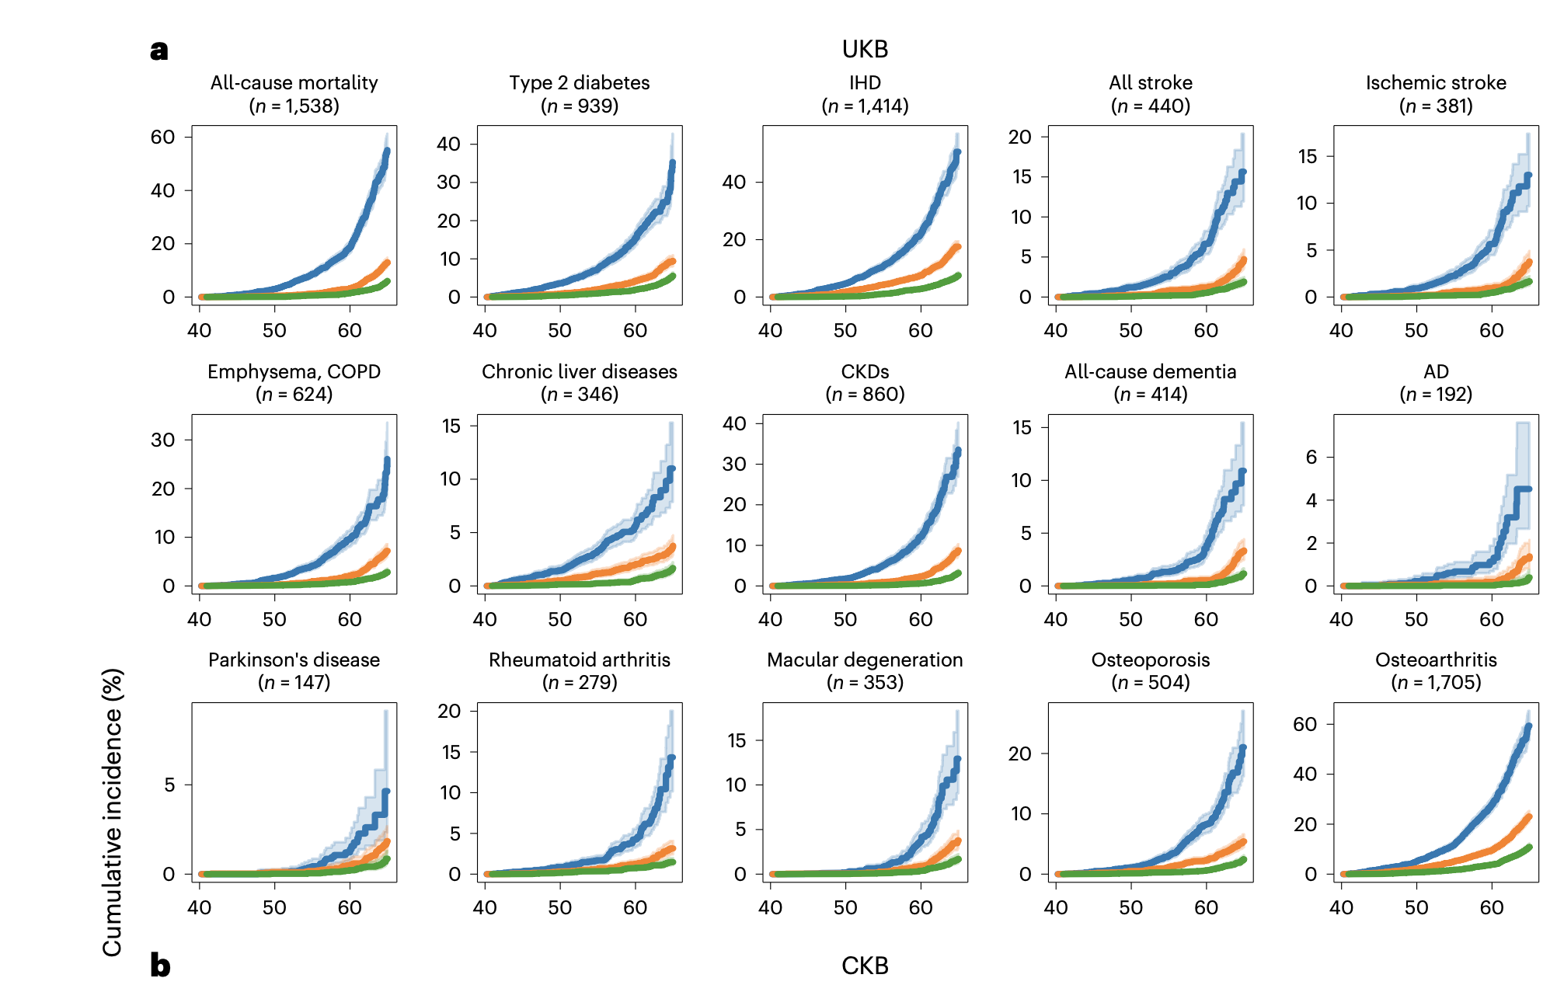
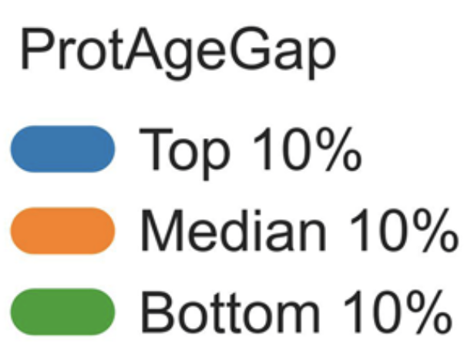
Back to the Protein (ProtAge) Blood Biomarker
Protein Age Gap
Cumulative Incidence (%)
Patient age at entry into the dataset
Argentieri, M. Austin, et al. "Proteomic aging clock predicts mortality and risk of common age-related diseases in diverse populations." Nature medicine 30.9 (2024): 2450-2460.

Slide 69
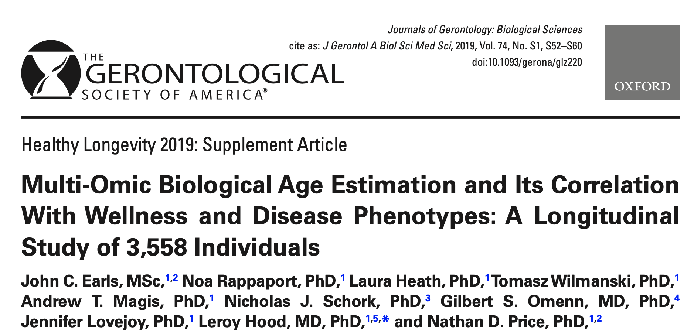
Biomarker = multimodal data including metabolites, proteins, and lab values
This is commercially available

Slide 70
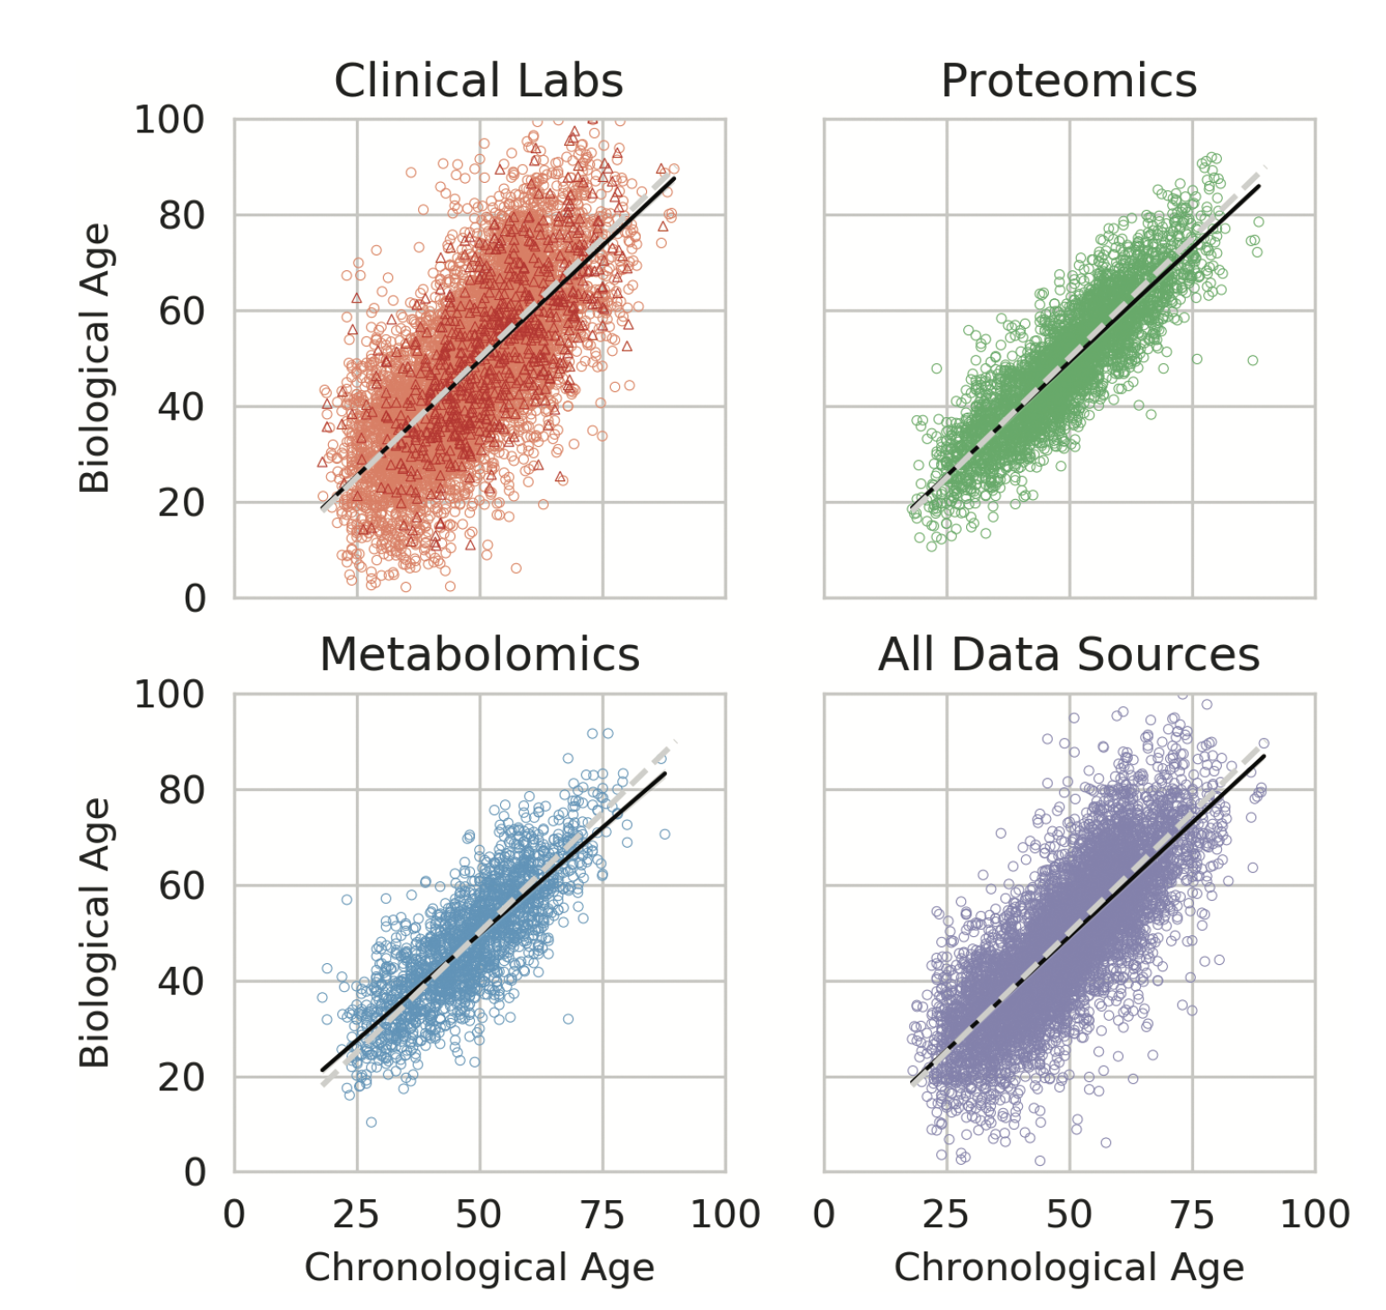

Slide 71
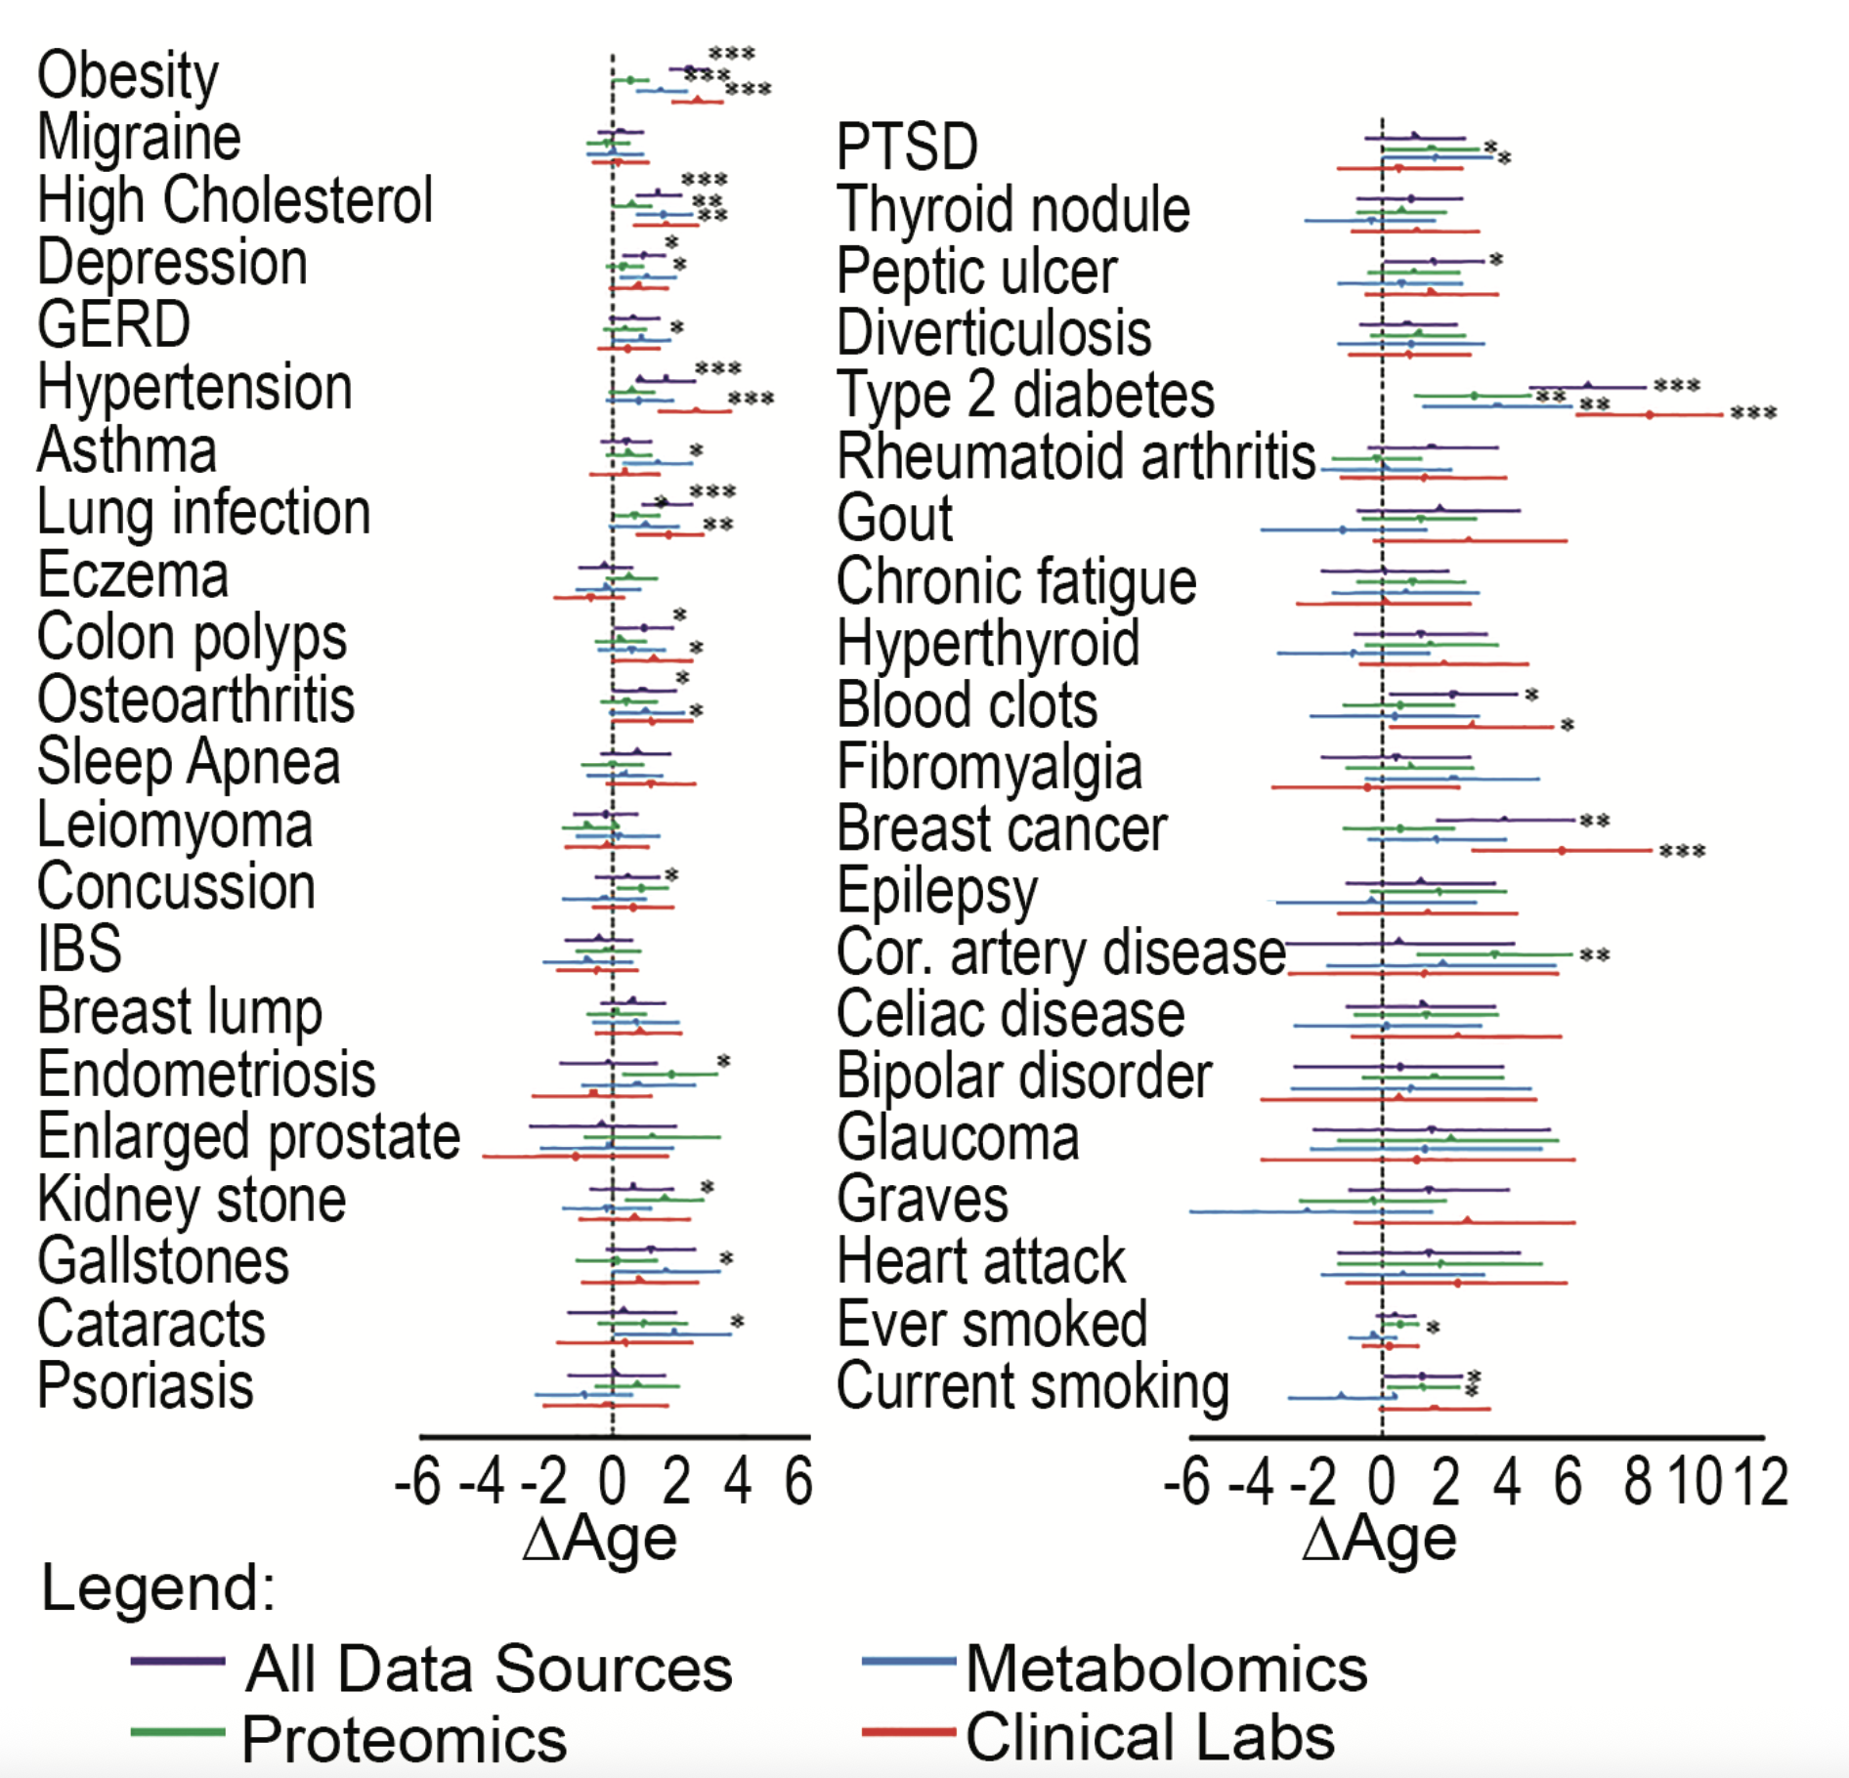

Slide 72
Do biomarkers generally hold across ethnic, cultural, and geographic differences?

Slide 73
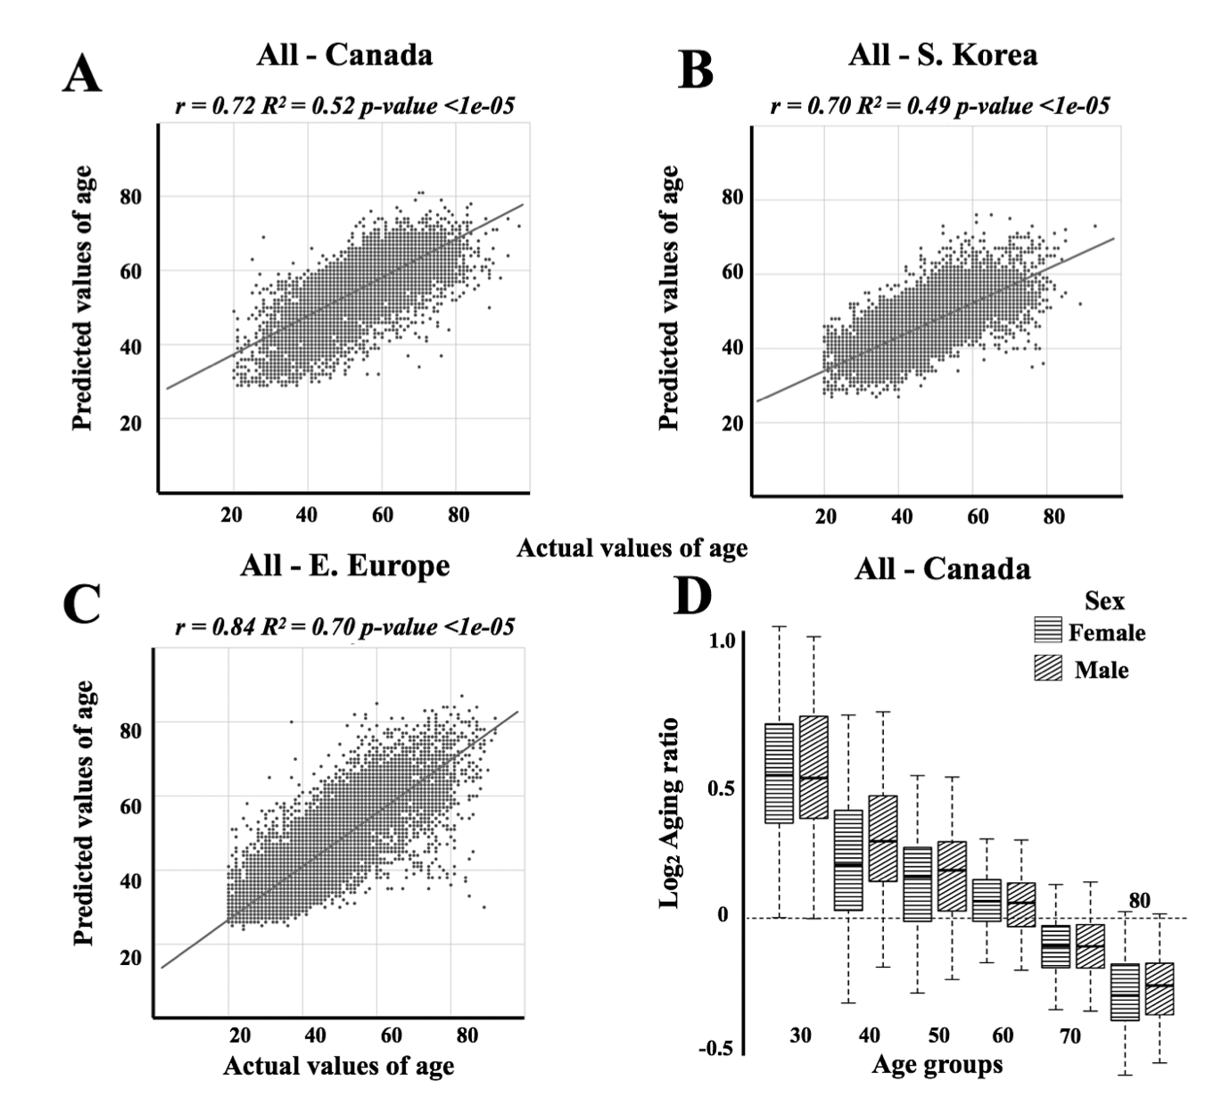
Biomarkers generally work across ethnic, geographic, and cultural backgrounds, but may require fine tuning
Mamoshina, Polina, et al. "Population specific biomarkers of human aging: a big data study using South Korean, Canadian, and Eastern European patient populations." The Journals of Gerontology: Series A 73.11 (2018): 1482-1490.

Slide 74
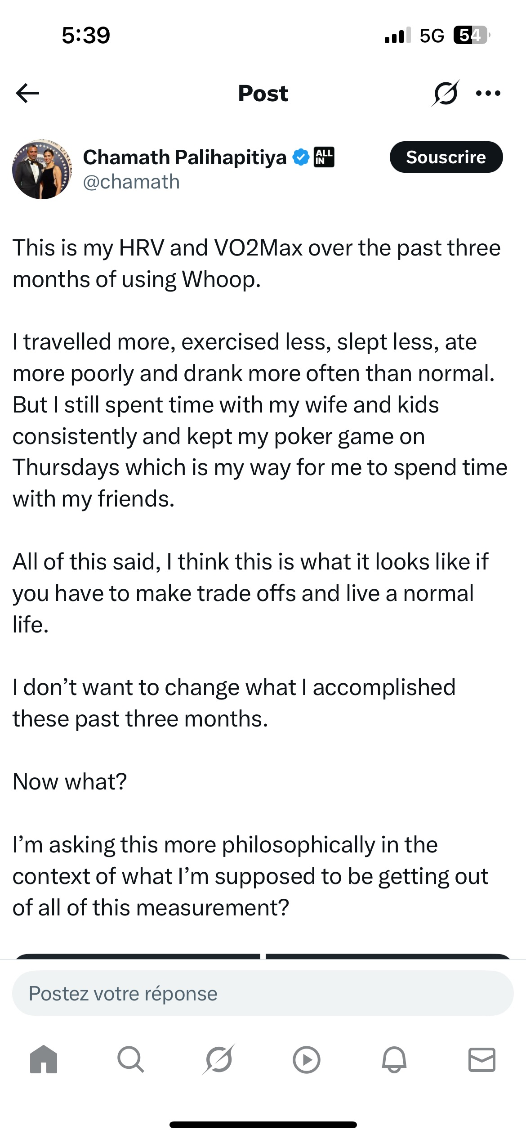
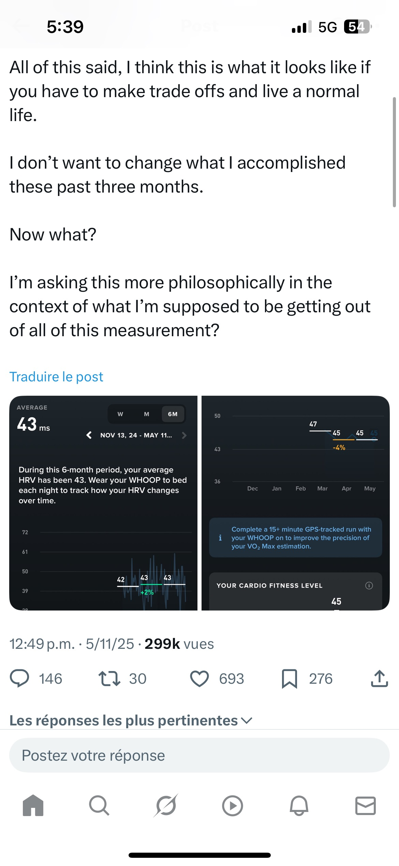

Slide 75
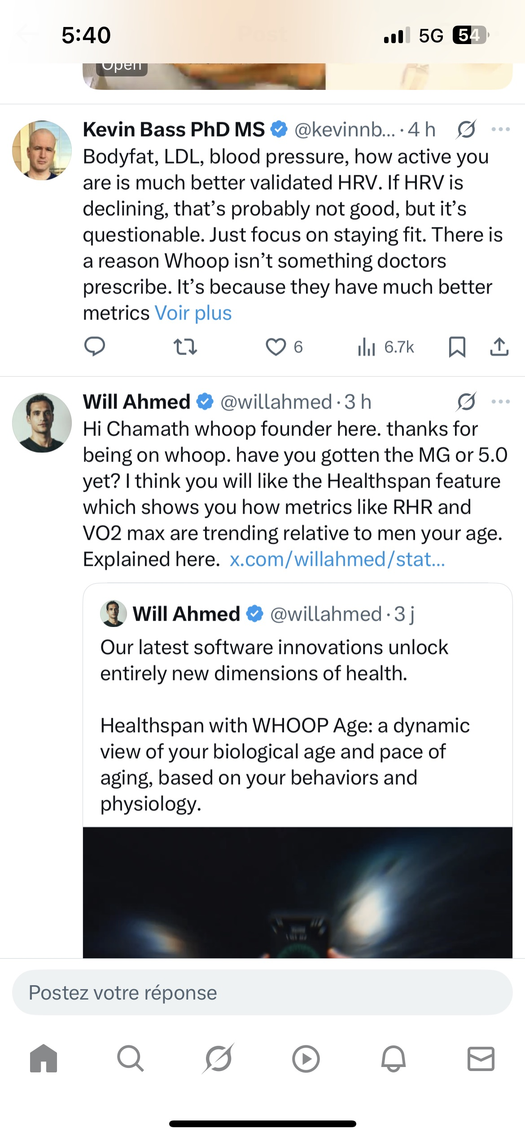

Slide 76
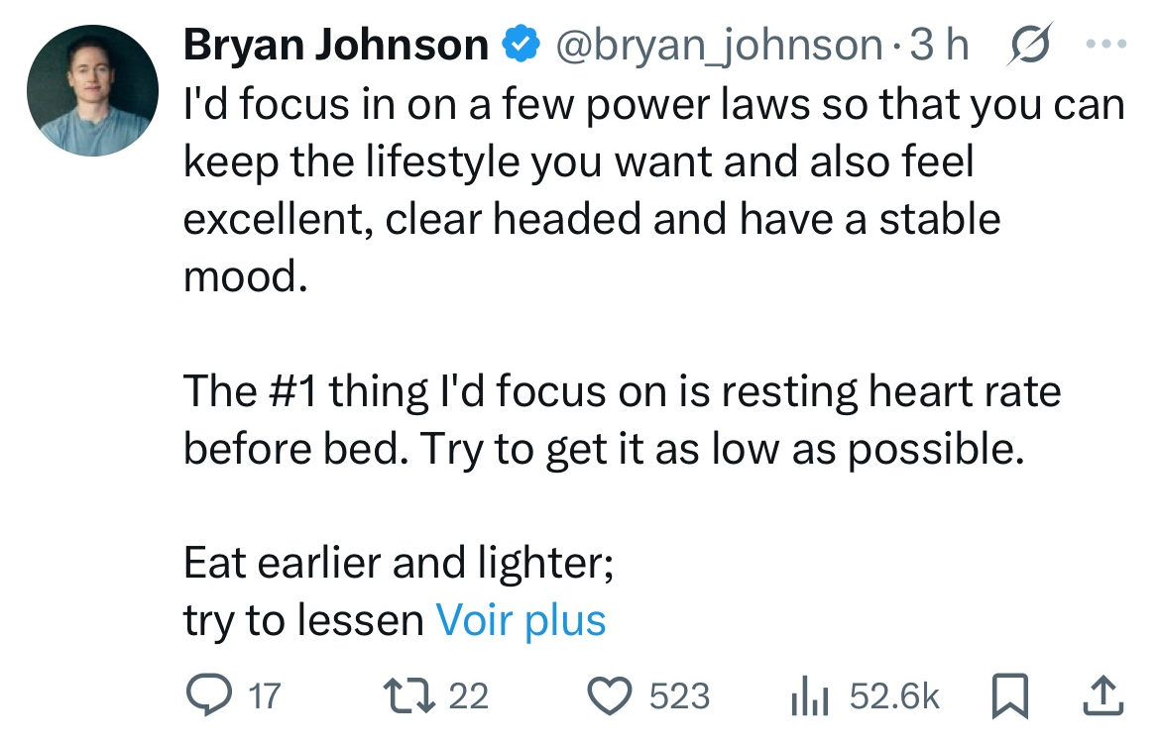

Slide 77
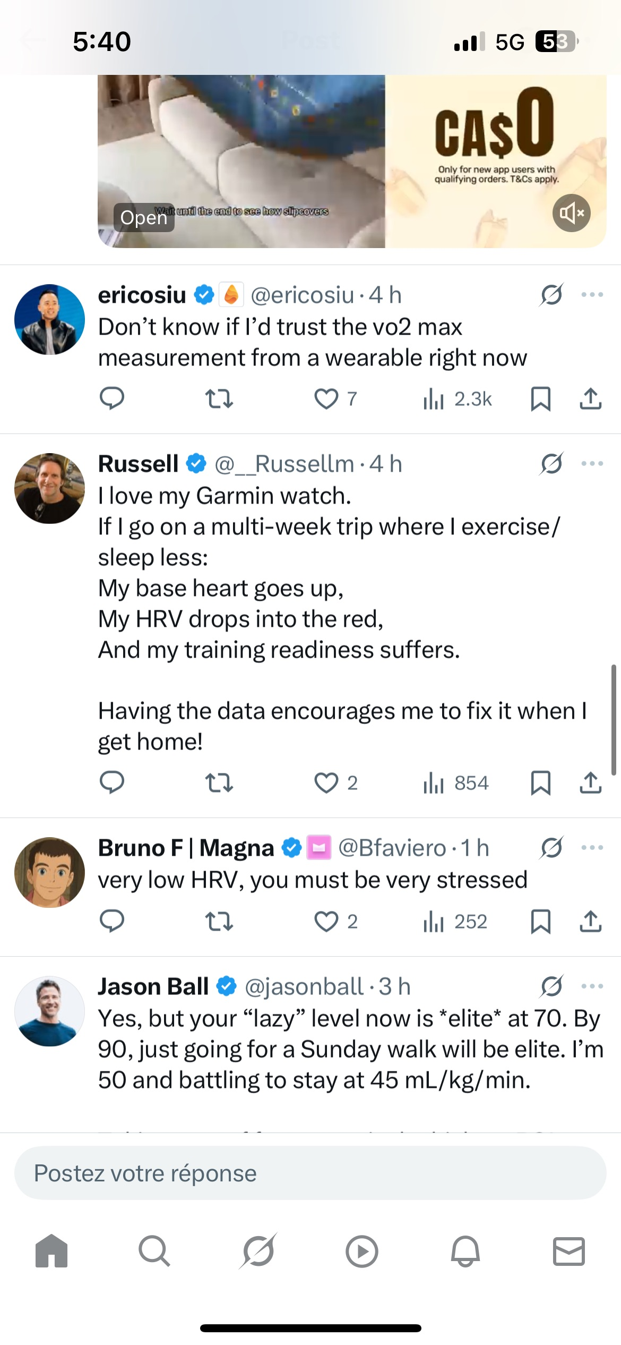

Slide 78
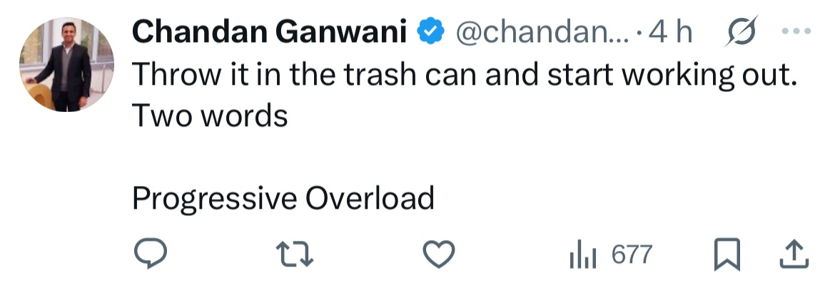

Slide 79
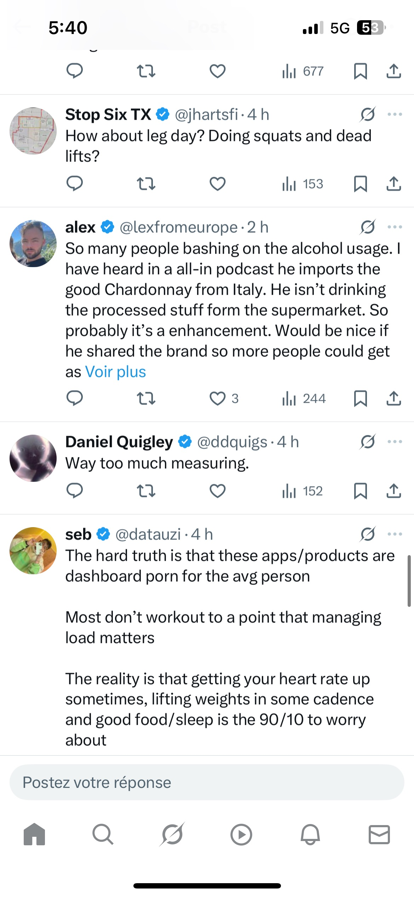

Slide 83
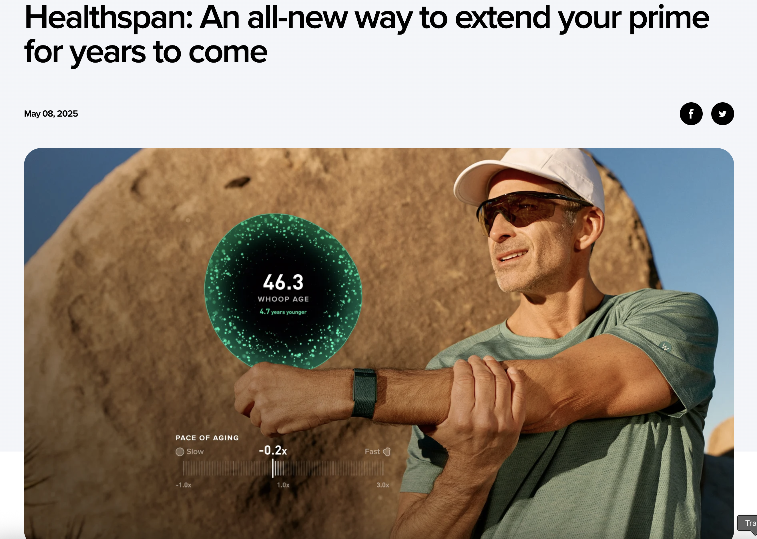
May 8 2025
Whoop

Slide 84


Slide 85




Slide 86
How will AI and LLMs measure and act as biomarkers, and how will they allow us to understand and even extend longevity

Slide 87



Slide 88




May 8 2025
Bontempi, Dennis, et al. "FaceAge, a deep learning system to estimate biological age from face photographs to improve prognostication: a model development and validation study." The Lancet Digital Health (2025).

Slide 89


FaceAge determined by AI significantly predicts and stratifies overall survival in patients with cancer
Bontempi, Dennis, et al. "FaceAge, a deep learning system to estimate biological age from face photographs to improve prognostication: a model development and validation study." The Lancet Digital Health (2025).

Slide 90

FaceAge determined by AI significantly distinguishes patients who smoke from non-smokers
Bontempi, Dennis, et al. "FaceAge, a deep learning system to estimate biological age from face photographs to improve prognostication: a model development and validation study." The Lancet Digital Health (2025).

Slide 91

FaceAge AI strongly predicts survival at 6 months, does so better than doctors, and can be used by doctors to improve their own predictions
Bontempi, Dennis, et al. "FaceAge, a deep learning system to estimate biological age from face photographs to improve prognostication: a model development and validation study." The Lancet Digital Health (2025).

Slide 92


Slide 93
Let’s reflect upon our journey through chronological time
and chronological age

Slide 94
Santorio Santorio
1613

Slide 95







Santorio Santorio
1613
2025

Slide 96


Santorio Santorio
1613
2025

Slide 97
Next steps

Slide 98
Next steps
Figuring out what is noise/hype, and what is real and will stand the test of time

Slide 99
Just because something correlates with age, doesn’t mean that it causes age
But if there is real biology at play, biomarkers may give hints for new therapeutic targets against aging

Slide 100



How much can we personalize recommendations using this biomarker data?

Slide 101
How much can we personalize recommendations using this biomarker data?
Stroke
Cardiovascular
(Tissues of the blood vessels, and heart)
Heart Attack
COPD
Neurodegeneration
Autoimmune
disease
Neurological
(Tissues of the nervous system)
Metabolic
(The ensemble of metabolic interactions in our body)
Cancer

Slide 102
Next steps
Predicting disease and organ specific health and longevity
To enable specific screening and interventions

Slide 103


What do we actually do with all of this data:
Clinical trial end points

Slide 104
Can we demonstrate that measuring these biomarkers actually improves healthspan?

Slide 105
Next steps
More and more, integrating using LLMs to read a patient’s clinical chart to infer a biomarker age and healthspan

Slide 106
Next steps
Getting patient, physician, and insurance buy in

Slide 107
Next steps
Demonstrating actual benefit to lifespan, healthspan, symptoms, or concrete outcomes

Slide 108
Next steps
Demonstrating actual benefit to lifespan, healthspan, symptoms, or concrete outcomes
Can you prove that measuring these things actually helps people

Slide 109
Next steps
Demonstrating actual benefit to lifespan, healthspan, symptoms, or concrete outcomes
Can you prove that measuring these things actually helps people
RCTs

Slide 110
Next steps
Does Biomarker Age gap actually correlate with healthspan or mortality?

Slide 112
“Not Everything That Can Be Measured Matters, and Not Everything That Matters Can Be Measured”
Einstein (probably misattributed)

Slide 113
Maybe it is a vibe?

Slide 114


It’s a vibe
It’s a vibe

Slide 115
“LGFD”
It’s a vibe
It’s a vibe

Slide 116
We need Age gap or biomarkers in general that actually translate to better lifespan and healthspan

Slide 117
Where we came from:
One of the great challenges of our time is that human lifespan has stopped increasing, and healthspan has contracted

Slide 118
Will we be able to improve healthspan?

Slide 119


Slide 120
What will life expectancy in the next 50 years look like
1600,
~33 years
400 BC,
~25 years
400 BC
1600

Slide 121
How do we overcome health and lifespan stagnation
1600,
~33 years
400 BC,
~25 years
400 BC
1600
Notes:
The increase in lifespan from ancient times was the product of human innovation in therapeutics, public health, infrastructure, sanitation, and and diplomatic efforts for peace. We stand now in 2025 in a time of life expectancy stagnation and healthspan contraction, and it is incumbent upon us as innovators, scientists, doctors, and patients to accept the baton passed to us by our ancestors, and increase healthspan for our own and future generations

Slide 122
Biomarkers will allow us not only to measure the progress in our own health journey
But also our progress in the critical human endeavor of increasing health and life span

Slide 123
There is an urgent need to overcome health and lifespan stagnation

Slide 124
We can measure quantities (biomarkers), and they likely can help us to estimate longevity and healthspan

Slide 125
But can we measure quantities that indicate and predict a life worth living?

Slide 126
You have years ahead of you, and I want those years to be filled with health and happiness

Slide 127
Thank you

Slide 128
TODO:
Bring it back to Grip Strenght, blood pressure, cholesterol, the basics
Add any evaluation of Whoop healthspan
Add another wearable?
Delete second age biomarker paper
Show that organ specific data matters
Show that there are RCTs where they use these biomarkes as endpoints, so that they actually matter
AI
Bring it back to lifespan and age rates over time

Slide 129
EXTRA SLIDES NOT USED

Slide 130
EXTRA SLIDES NOT USED

Slide 131
EXTRA SLIDES NOT USED

Slide 132


Life expectancy, 2023
Wikipedia

Slide 133
But what is a life worth living

Slide 134
What is a life of thriving

Slide 136


Slide 137
bi·o·mark·er
/ˈbīōˌmärkər/

Slide 138
1935 Caloric restriction in rats is seen to increase lifespan

Slide 139


Slide 140
Epigenetic Clock
Jim Kirkland Aging
American Federation for Aging
Buck

Slide 141


Slide 142
https://einsteinmed.edu/faculty/484/nir-barzilai

Slide 143
Response biomarkers
Prognostic

Slide 144


Slide 145


Slide 146


Slide 148
How far have we come

Slide 149
How far have we come

Slide 150


Slide 151


Slide 153




Lozano, Chaudhuri, Nene, Newman et al. Nature Medicine 2022

Slide 154

How far have we come
Biomarkers have been a part of western medicine for over 170 years
Serum Free Light Chains (antibodies) were first used as markers for myeloma (a blood cancer) in 1847
Image https://www.drugtargetreview.com/news/104433/a-new-study-has-highlighted-how-an-antibody-strengthens-bonds-between-cells/

Slide 155
If Age is perhaps the most important predictor of disease, can we say that they share a
causal relationship?

Slide 156
If Age causes disease, can we then treat it?

Slide 157
There is no Age, there is only health.

Slide 158
The one true clock is not age, but our health

Slide 159
ProtAgeGap

Slide 160
Should we screen people with protein age gaps more frequently for chronic conditions

Slide 161


Slide 162


Slide 163
leading DNAm clocks, including the Horvath clock22, DNAm PhenoAge23 and DunedinPACE24 (E

Slide 164

Genetic predictors of age

Slide 165
References
Wikipedia
Our World in Data

Slide 166
What will you do with your time on this earth

